Slide 1
Important articles or practice exams https://www.braincert.com/course/16401-Google-Cloud-Certified-Professional-Cloud-Architect-Practice-Exams?token=151c71a52a#
My public badge profile with wipro
https://partner.cloudskillsboost.google/public_profiles/db4cd706-17e1-4990-8aae-e84d9d01a29d
Whizlabs sample test questions - https://www.whizlabs.com/learn/course/google-cloud-certified-professional-cloud-architect/239 https://www.whizlabs.com/learn/course/google-cloud-certified-professional-cloud-architect/239/quiz/14777/report/6154892
Persnonal profile https://www.cloudskillsboost.google/public_profiles/90b1b58e-56a6-4c52-832e-b3b172a5bb95

Slide 2
Case Study --Helicopter racing league – HRL - (PCA exam ) question reference : Q1. How can you manage both live streaming and live annotation (Wizlab)
https://cloud.google.com/video-intelligence/docs/streaming/live-streaming-overview
https://cloud.google.com/blog/products/data-analytics/streaming-video-using-cloud-data-platform
Q17. There is a need to transform media in to different streaming format , so as to optimize for different format.
https://cloud.google.com/transcoder/docs/concepts/overview
***Telemetry – is important for this case study -- Operation suit / ISTIO / Prometheus / Service Control API --and in this link you can study about ISTIO telemetry solution and how it can help a customer - https://www.coursera.org/lecture/hybrid-cloud-service-mesh-anthos/telemetry-and-observability-in-service-mesh-jeANQ https://istio.io/latest/about/service-mesh/ (OPEN SOURCE) --Google Telemetry service → Service control API v2
https://cloud.google.com/service-infrastructure/docs/telemetry-reporting -- another open source solution https://prometheus.io/docs/introduction/overview/

Slide 3
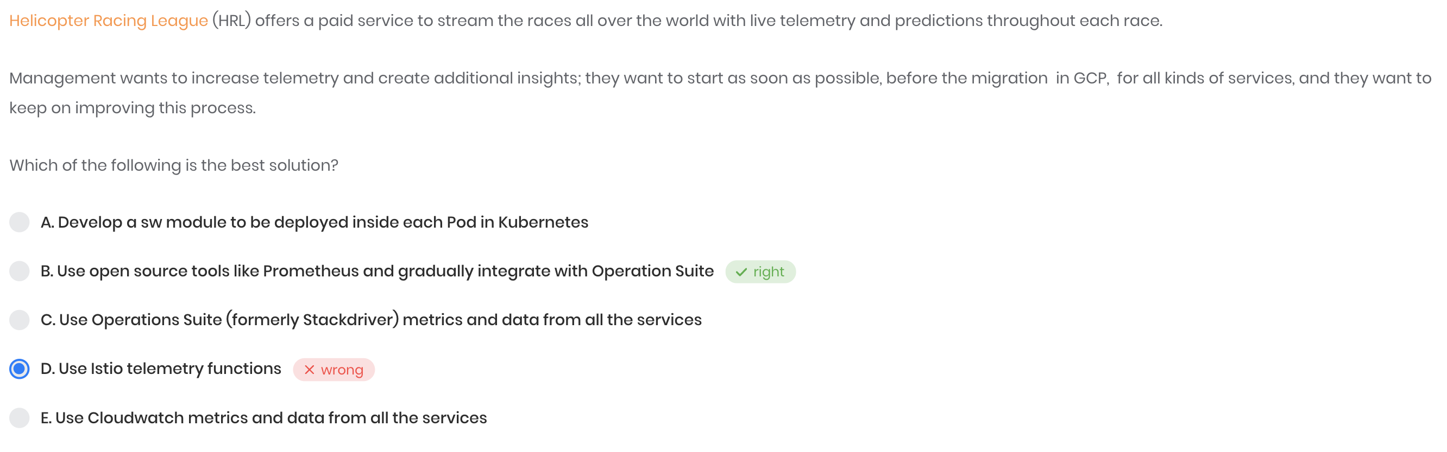
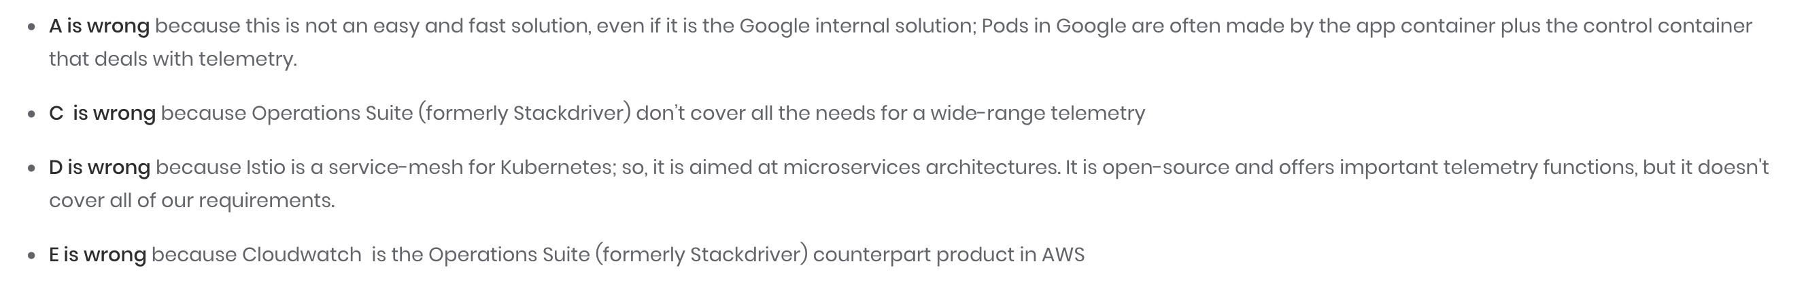
Continuation to HRL case study. …..
Why ISTIO is not covering all requirement :
Istio manages traffic flows between services, enforces access policies, and aggregates telemetry data of that traffic.
Whereas Prometheus is used for event monitoring and alerting. It records real-time metrics in a time series database.
https://cloud.google.com/stackdriver/docs/managed-prometheus Why Prometheus and not operation suit As question states "start as soon as possible" :For this, solution is "Prometheus "and other section of the question says, "want to keep on improving this process":For this, a solution is "Operations Suite"
Option C: "Operations Suite" is also a correct solution but it's a permanent solution and may need some time to implement.However by starting Prometheus: it starts as soon as possible and gradually change to a permanent solution.

Slide 4
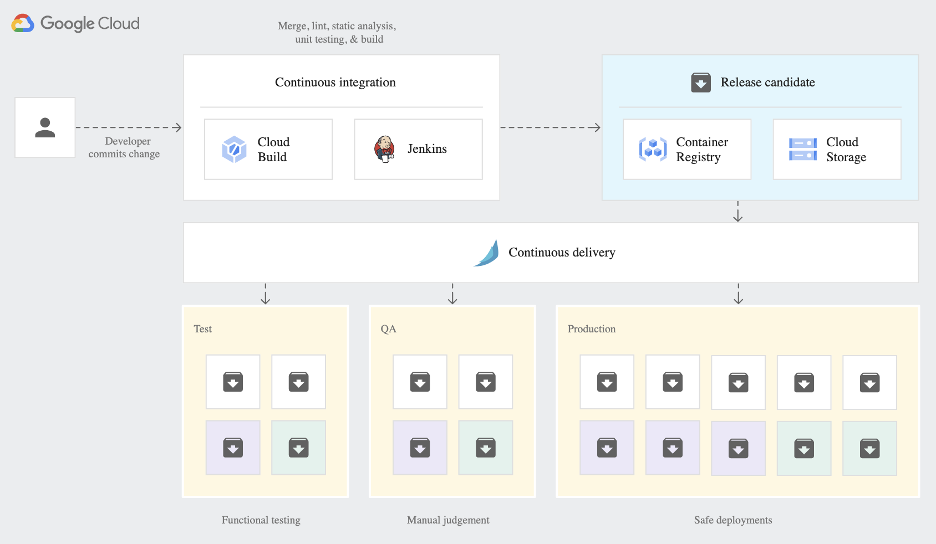
Case study -- EHR healthcare (PCA exam )
--How to design its CI-CD --difference between Google build and spinnaker and jenkin
Spinnaker - https://cloud.google.com/architecture/continuous-delivery-toolchain-spinnaker-cloud
google CI-CD - https://cloud.google.com/docs/ci-cd?hl=en
Spinnaker vs Jenkin https://www.opsmx.com/blog/jenkins-vs-spinnaker/#:~:text=Jenkins%20lacks%20capabilities%20as%20a,integrate%20with%20tools%20like%20Jenkins.
A CI-CD pipeline using Spinnaker and cloud build
Google Cloud Build vs Spinnaker: What are the differences?
What is Google Cloud Build? Continuously build, test, and deploy. Cloud Build lets you build software quickly across all languages. Get complete control over defining custom workflows for building, testing, and deploying across multiple environments such as VMs, serverless, Kubernetes, or Firebase.
What is Spinnaker? Multi-cloud continuous delivery platform for releasing software changes with high velocity and confidence. Created at Netflix, it has been battle-tested in production by hundreds of teams over millions of deployments. It combines a powerful and flexible pipeline management system with integrations to the major cloud providers.
Google Cloud Build and Spinnaker belong to "Continuous Deployment" category of the tech stack.
Spinnaker is an open source tool

Slide 5
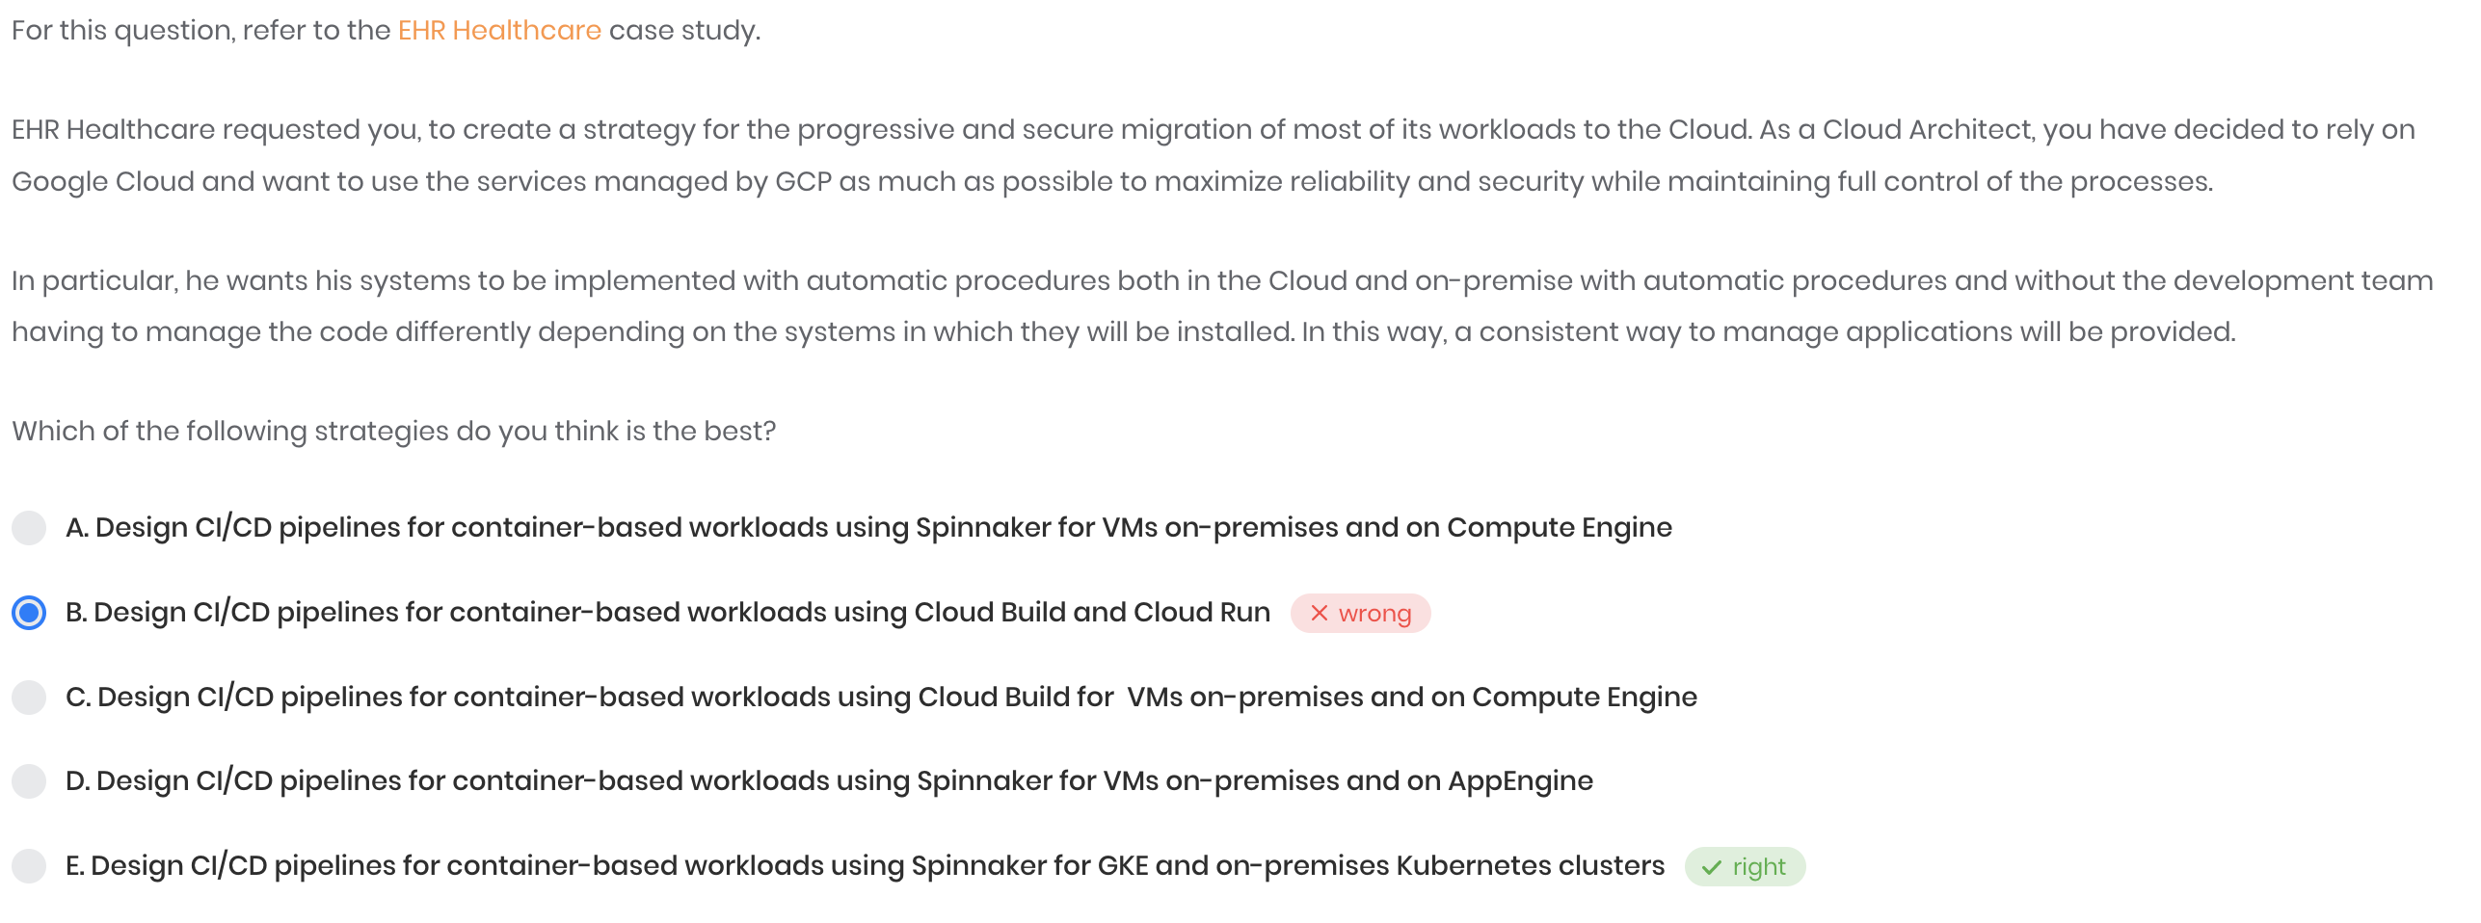
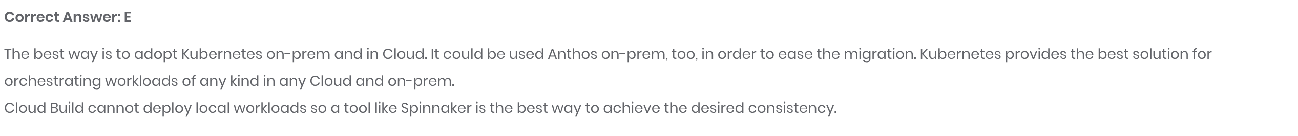
Ci-cd required for on – premises also , that is why cloud build is not a right option
There are better options but as they are not mentioned in the provided options , so spinnaker is the best . Cloud Run for Anthos (CRFA) is On-Prem option. Cloud Build recently was announced to work on-Prem with Private pools, Or if you use Anthos Connect you can deploy from Cloud Build to GKE On-Prem too. Just to tell that this question is non-trivial to anaswer as I would not recommend customer use Spinnaker this days, perhaps tools like Gitlab or ArgoCD will be more suitable. Hopefully this is not going to be in a exam
https://cloud.google.com/anthos/docs/setup/on-premises

Slide 6
Case Study – Mountkirk Games

Slide 7
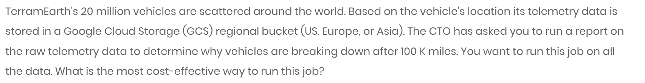
Case Study – Terram Earth
Question 7 – paper 1

Slide 8
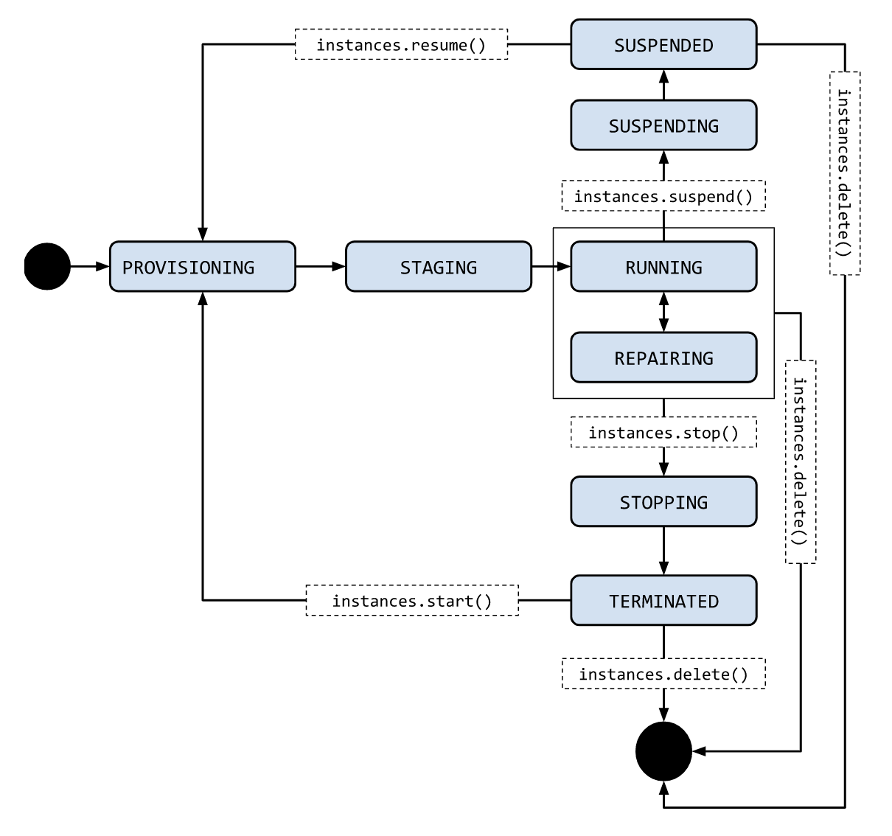
 | Stopping | Suspending | Resetting
Billing | Google does not charge for VM resources while they are in the TERMINATED state. | Google charges for storing the preserve state of suspended VMs. | Because the VM remains in the RUNNING state when it is resetting, Google charges for VMs according to standard VM prices.
VM state | TERMINATED | SUSPENDED | RUNNING
Persistent disks | Persistent disks are maintained, even when persistent disks are marked for auto-delete. You are charged for a persistent disk that is associated with a stopped VM, just like you are charged for a persistent disk that is not associated with a VM. | Persistent disks are maintained, even when persistent disks are marked for auto-delete. You are charged for a persistent disk that is associated with a stopped VM, just like you are charged for a persistent disk that is not associated with a VM. | Persistent disks are maintained, even when persistent disks are marked for auto-delete. You are charged for persistent disks as long as the VM remains in a RUNNING state.
RAM and VM state | Reset to power-on state, no data is saved. | Guest OS and application state is preserved and restored when the VM is resumed. You are charged a specific rate for storing preserved data. For more information, see Billing for suspended instances. | Reset to power-on state, no data is saved.
GPUs | GPUs are not charged when a VM is stopped. A GPU that is attached to a TERMINATED VM doesn't count against your project quota. | Not supported. If a GPU is attached to a VM, you cannot suspend the VM. | You are charged standard GPU prices.
Local SSDs | Not supported. You cannot stop a VM that has a local SSD attached to it. | Not supported. You can suspend a VM that has a local SSD, but you must explicitly discard the local SSD data in the process. | Local SSDs are maintained.
External ephemeral IPs | Ephemeral IPs are released when a VM is stopped, but a new ephemeral IP address is acquired when the VM restarts. | Ephemeral IPs are released when a VM is suspended, but a new ephemeral IP address is acquired when the VM restarts. | Ephemeral IPs are released when a VM is reset, but a new ephemeral IP address is acquired when the VM restarts.
External static IPs | Static external IPs are maintained. Static IPs that are assigned to VMs in the TERMINATED state are charged as if they aren't attached to any VM. For more information, see pricing. | Static external IPs are maintained. Static IPs that are assigned to VMs in the SUSPENDED state are charged as if they aren't attached to any VM. For more information, see pricing. | Static external IPs are maintained.
Internal IPs or MAC addresses | Internal IPs and MAC addresses are maintained. | Internal IPs and MAC addresses are maintained. | Internal IPs are released when a VM is deleted. MAC addresses are generated based on the internal IP. If you want to reuse the MAC address, set the same internal IP address or use a reserved internal IP.
VM metadata | VM metadata is maintained. | VM metadata is maintained. | VM metadata is maintained.
Instance life cycle - https://cloud.google.com/compute/docs/instances/instance-life-cycle
Reference question : https://www.whizlabs.com/learn/course/google-cloud-certified-professional-cloud-architect/239/quiz/14777/report/6154892

Slide 9
Cloud deployment manager Q1. business risk to migrate to the deployment manager
https://cloud.google.com/deployment-manager/docs/deployments/deleting-deployments
Select a delete policy
The delete policy you use determines how the resources in the deployment are handled. You can use one of these policies:
DELETE [Default]: Deletes the underlying resource. This is permanent and cannot be undone.
ABANDON: This deletes the deployment, but does not delete the underlying resources. For example, if you have a VM instance in the deployment, it will still be available for you to use after the deployment is deleted.
If you need to re-create a deployment that you deleted, you can use the original configuration file. However, the deployment is considered a new deployment, with new resources.
Access control ---- https://cloud.google.com/deployment-manager/docs/access-control
-- To create other Google Cloud resources, Deployment Manager uses the credentials of the Google APIs Service Agent to authenticate to other APIs. The Google APIs Service Agent is designed specifically to run internal Google processes on your behalf. This service account is identifiable using the email:
How to - https://cloud.google.com/deployment-manager/docs/manage-cloud-resources-deployment Best Practicing - https://cloud.google.com/deployment-manager/docs/best-practices
Role | Permissions
Deployment Manager Editor (roles/deploymentmanager.editor) Provides the permissions necessary to create and manage deployments. Lowest-level resources where you can grant this role: Project | deploymentmanager.compositeTypes.* deploymentmanager.deployments.cancelPreview deploymentmanager.deployments.create deploymentmanager.deployments.delete deploymentmanager.deployments.get deploymentmanager.deployments.list deploymentmanager.deployments.stop deploymentmanager.deployments.update deploymentmanager.manifests.* deploymentmanager.operations.* deploymentmanager.resources.* deploymentmanager.typeProviders.* deploymentmanager.types.* resourcemanager.projects.get resourcemanager.projects.list serviceusage.quotas.get serviceusage.services.get serviceusage.services.list
Deployment Manager Type Editor (roles/deploymentmanager.typeEditor) Provides read and write access to all Type Registry resources. Lowest-level resources where you can grant this role: Project | deploymentmanager.compositeTypes.* deploymentmanager.operations.get deploymentmanager.typeProviders.* deploymentmanager.types.* resourcemanager.projects.get resourcemanager.projects.list serviceusage.quotas.get serviceusage.services.get
Deployment Manager Type Viewer (roles/deploymentmanager.typeViewer) Provides read-only access to all Type Registry resources. Lowest-level resources where you can grant this role: Project | deploymentmanager.compositeTypes.get deploymentmanager.compositeTypes.list deploymentmanager.typeProviders.get deploymentmanager.typeProviders.getType deploymentmanager.typeProviders.list deploymentmanager.typeProviders.listTypes deploymentmanager.types.get deploymentmanager.types.list resourcemanager.projects.get resourcemanager.projects.list serviceusage.quotas.get serviceusage.services.get
Deployment Manager Viewer (roles/deploymentmanager.viewer) Provides read-only access to all Deployment Manager-related resources. Lowest-level resources where you can grant this role: Project | deploymentmanager.compositeTypes.get deploymentmanager.compositeTypes.list deploymentmanager.deployments.get deploymentmanager.deployments.list deploymentmanager.manifests.* deploymentmanager.operations.* deploymentmanager.resources.* deploymentmanager.typeProviders.get deploymentmanager.typeProviders.getType deploymentmanager.typeProviders.list deploymentmanager.typeProviders.listTypes deploymentmanager.types.get deploymentmanager.types.list resourcemanager.projects.get resourcemanager.projects.list serviceusage.quotas.get serviceusage.services.get serviceusage.services.list

Slide 10
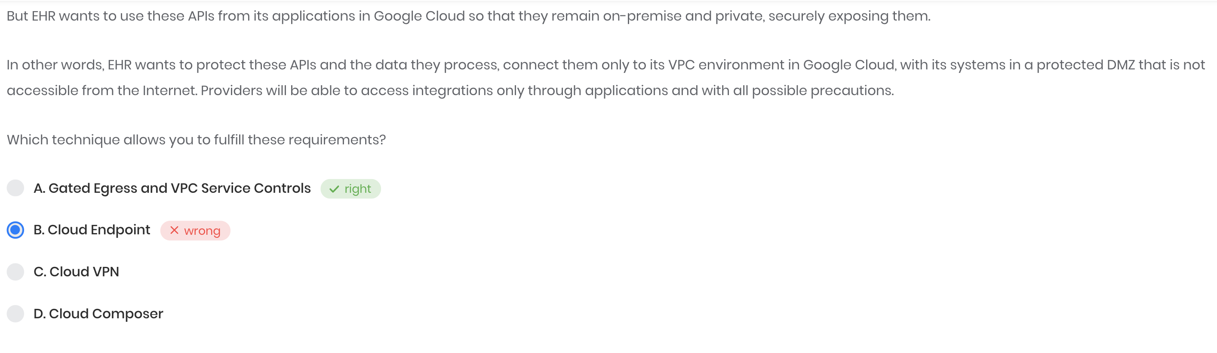
Firewall rules :
Gated egress → https://cloud.google.com/architecture/hybrid-and-multi-cloud-network-topologies#gated-egress VPC service control → https://cloud.google.com/vpc-service-controls#all-features
Apigee for private cloud - https://docs.apigee.com/private-cloud/versions

Slide 11
Amazon S3 transfers- https://cloud.google.com/bigquery-transfer/docs/s3-transfer
Required permissions
Before creating an Amazon S3 transfer:
Ensure that the person creating the transfer has the following required permissions in BigQuery:
bigquery.transfers.update permissions to create the transfer
Both bigquery.datasets.get and bigquery.datasets.update permissions on the target dataset
The bigquery.admin predefined IAM role includes bigquery.transfers.update, bigquery.datasets.update and bigquery.datasets.get permissions. For more information on IAM roles in BigQuery Data Transfer Service, see Access control reference.
Consult the documentation for Amazon S3 to ensure you have configured any permissions necessary to enable the transfer. At a minimum, the Amazon S3 source data must have the AWS managed policy AmazonS3ReadOnlyAccess applied to it.
Limitations
Amazon S3 transfers are subject to the following limitations:
Currently, the bucket portion of the Amazon S3 URI cannot be parameterized.
Transfers from Amazon S3 are always triggered with the WRITE_APPEND preference which appends data to the destination table. See configuration.load.writeDisposition in the load job configuration for additional details.
Depending on the format of your Amazon S3 source data, there may be additional limitations. For more information, see:
CSV limitations
JSON limitations
Limitations on nested and repeated data
The minimum interval time between recurring transfers is 24 hours. The default interval for a recurring transfer is 24 hours.

Slide 12
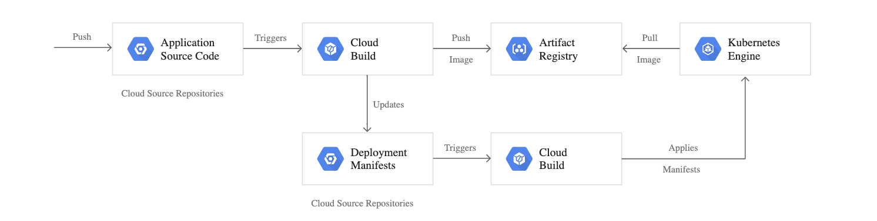
CI-CD/ gitOps ----------→> https://cloud.google.com/kubernetes-engine/docs/tutorials/gitops-cloud-build
GitOps - A key part of GitOps is the idea of "environments-as-code"

Slide 13
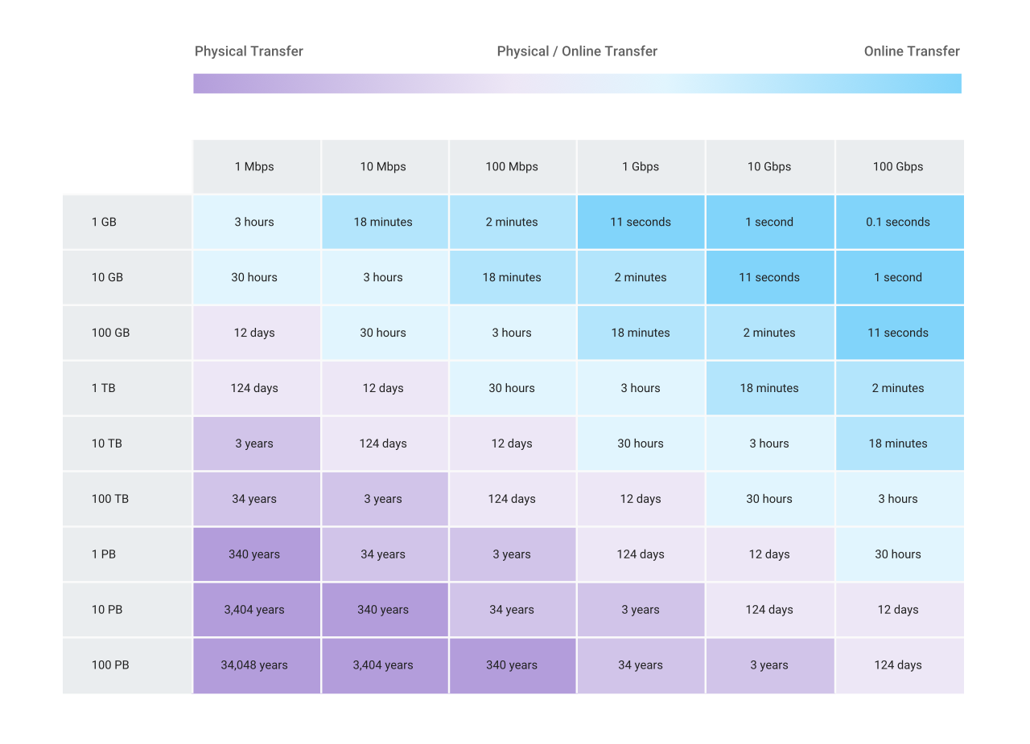
Data transfer questions
Storage transfer service → https://cloud.google.com/storage-transfer/docs/overview
When to use gsUtill
Transferring from another cloud storage provider | Use Storage Transfer Service.
Transferring less than 1 TB from on-premises | Use gsutil.
Transferring more than 1 TB from on-premises | Use Transfer service for on-premises data.
Transferring less than 1 TB from another Cloud Storage region | Use gsutil.
Transferring more than 1 TB from another Cloud Storage region | Use Storage Transfer Service.
Access Type | IAM roles
Full access | Storage Transfer Admin
Submitting transfers | Storage Transfer User
Viewing or listing transfer jobs and operations | Storage Transfer Viewer Note: Transfer service for on-premises data doesn't support the Storage Transfer Viewer role. Note ** Storage Transfer Service currently does not provide an SLA
Transfer appliance → https://cloud.google.com/transfer-appliance/docs/4.0/overview important point of upload table → → → > 10 TB and < 100 mbps -> use appliance
< 10 TB + 100 mbps -> online transfer
10 TB + > 100 mbps -> online transfer

Slide 14
Data transfer questions
Gsutill commands - https://cloud.google.com/storage/docs/gsutil/commands/cp#parallel-composite-uploads
Commands
gsutil cp <src> <des > | Copy file and objects
gsutil cp –n <src> <des > | You can use the -n option to prevent overwriting the content of existing files. The following example downloads text files from a bucket without clobbering the data in your directory:
gsutil cp -r dir gs://my-bucket | Use the -r option to copy an entire directory tree. For example, to upload the directory tree dir:
gsutil -m cp -r dir gs://my-bucket | If you have a large number of files to transfer, you can perform a parallel multi-threaded/multi-processing copy using the top-level gsutil -m option (see gsutil help options):

Slide 15
Storage Questions
-- How to store data of 6000 clicks per min with burst to 8500 clicks per sec
Quotas and limitation of big table - https://cloud.google.com/bigtable/quotas

Slide 16
Shared VPC
Q18 – one shared VPC + 3 project + 2 subnet in Host project . One subnet is shared in 2nd project, but that project is also able to see subnet 2 .. Why ??
https://cloud.google.com/vpc/docs/shared-vpc
https://cloud.google.com/vpc/docs/provisioning-shared-vpc
BEST -- https://www.youtube.com/watch?v=um3I4raPZFE
VPC network : https://cloud.google.com/vpc/docs/vpc
A Virtual Private Cloud (VPC) network is a virtual version of a physical network, implemented inside of Google's production network, using Andromeda
Offers native Internal TCP/UDP Load Balancing and proxy systems for Internal HTTP(S) Load Balancing.
Connects to on-premises networks using Cloud VPN tunnels and Cloud Interconnect attachments.
Projects can contain multiple VPC networks.
VPC networks can be connected to other VPC networks in different projects or organizations by using VPC Network Peering.
VPC networks can be securely connected in hybrid environments by using Cloud VPN or Cloud Interconnect.
VPC networks support GRE traffic, including traffic on Cloud VPN and Cloud Interconnect. VPC networks do not support GRE for Cloud NAT or for forwarding rules for load balancing and protocol forwarding.
GRE enables you to use services such as Secure Access Service Edge (SASE) and SD-WAN.
You can switch a VPC network from auto mode to custom mode. This is a one-way conversion; custom mode VPC networks cannot be changed to auto mode VPC networks.
Most important use case of custom mode VPC network is when you want to connect VPC networks by using VPC Network Peering or Cloud VPN. Because the subnets of every auto mode VPC network use the same predefined range of IP addresses, you cannot connect auto mode VPC networks to one another.
-
SUBNET - There are four reserved IP addresses in each subnet's primary IPv4 range. There are no reserved IP addresses in the secondary IPv4 ranges. - https://cloud.google.com/vpc/docs/subnets#valid-ranges
A subnet is not the same thing as a (VPC) network. Networks and subnets are different types of resources in Google Cloud.
- A network must have at least one subnet before you can use it. Custom mode VPC networks start with no subnets

Slide 17
Cloud Composer : https://cloud.google.com/composer/ Service that create , schedule monitor and manage workflow, without dealing with the management of infrastructure
--A fully managed workflow orchestration service built on Apache Airflow.

Slide 18
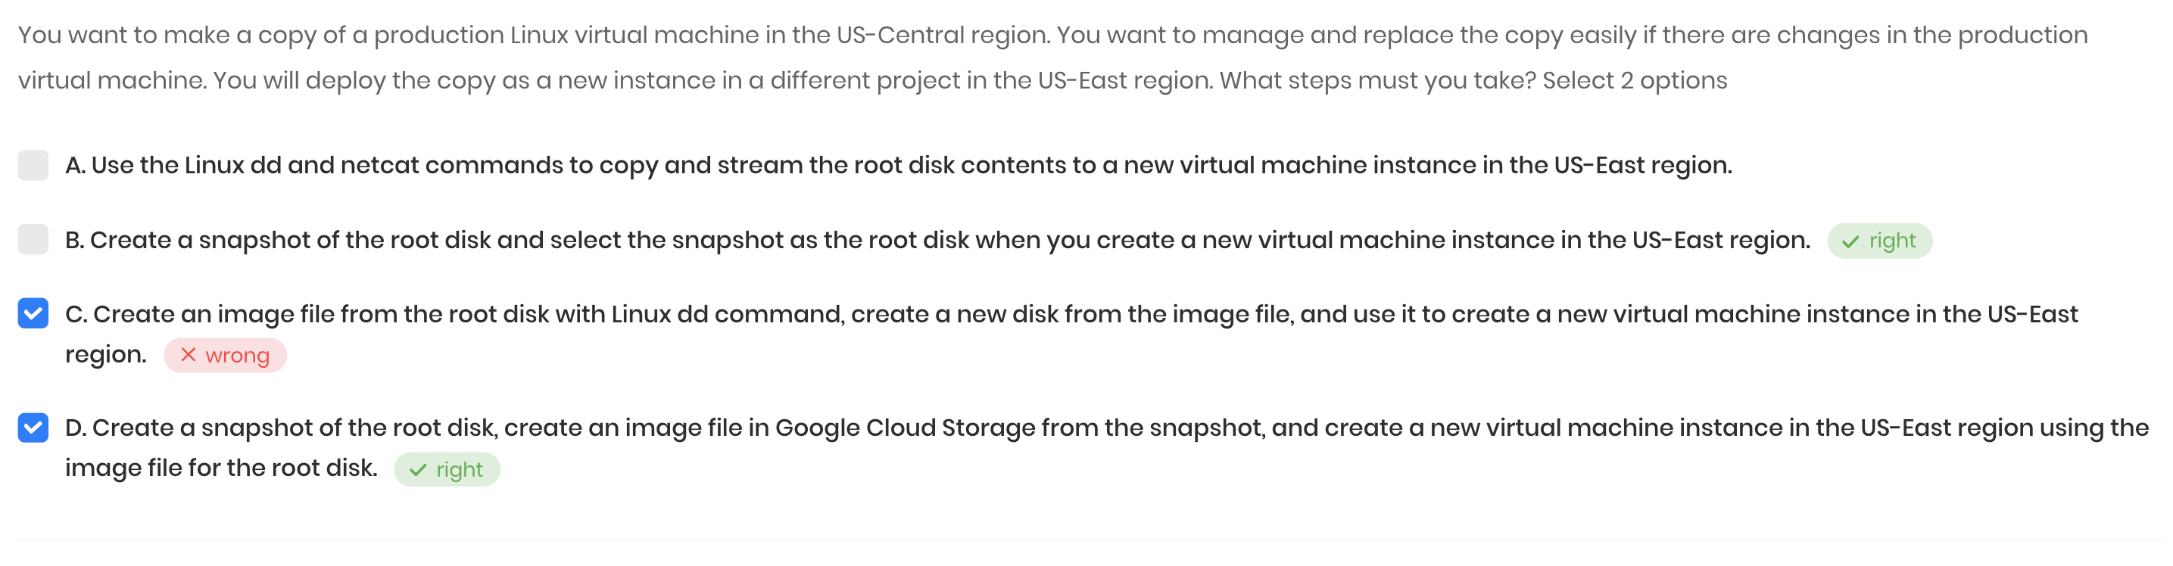
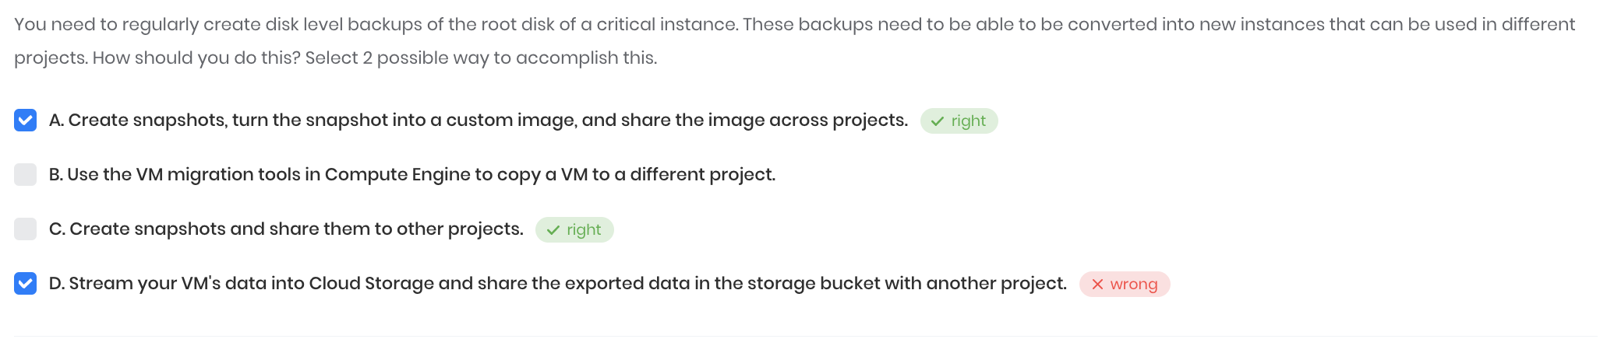
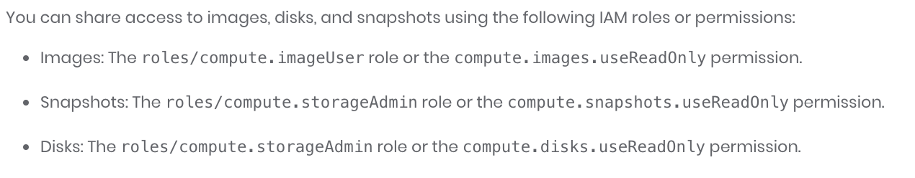
Snapshots
Q - How can transferring a snapshot to other projects work? Isnt snapshot local to a project unless it is image it wont work for other projects?
You cannot change the storage location of an existing snapshot. If you need to move a snapshot from one region or multi-regional location to another, you must create a new snapshot and specify its location, and delete the previous snapshot. When you create a snapshot, you can only specify one multi-regional location or one regional location. If you need to store a snapshot in more than one location, you must create a snapshot in each location.
For snapshot of one project to another: https://stackoverflow.com/questions/29585381/google-compute-engine-use-snapshot-from-another-project?utm_medium=organic&utm_source=google_rich_qa&utm_campaign=google_rich_qa
Q -Can the snapshot be used as the boot disk? the snapshot is recognizable as valid os boot disk?
We can share the snapshots of boot dist across the project and region. While booting up an instance we can select that image/snapshot to initiate the instance.
Q - How incremental snapshots works - https://cloud.google.com/compute/docs/disks/snapshots
Q - Difference between snapshots / images / instance template
https://cloud.google.com/compute/docs/machine-images#when-to-use
You can share the snapshot in between different project also - https://cloud.google.com/compute/docs/disks/create-snapshots#:~:text=You%20can%20create%20snapshots%20from,also%20share%20snapshots%20across%20projects. You can share disks in between projects via snapshots also. -- https://cloud.google.com/compute/docs/disks/create-snapshots#sharing_snapshots

Slide 20
Google Cloud's operations suite (formerly Stackdriver)

Slide 21
Customer-managed encryption keys - https://cloud.google.com/storage/docs/encryption/customer-managed-keys
Q1- When it is used

Slide 23
VM Migration -- https://cloud.google.com/architecture/migrating-vms-migrate-for-compute-engine-getting-started

Slide 24
Shutdown script for a Preemptible VM - https://cloud.google.com/compute/docs/shutdownscript

Slide 25
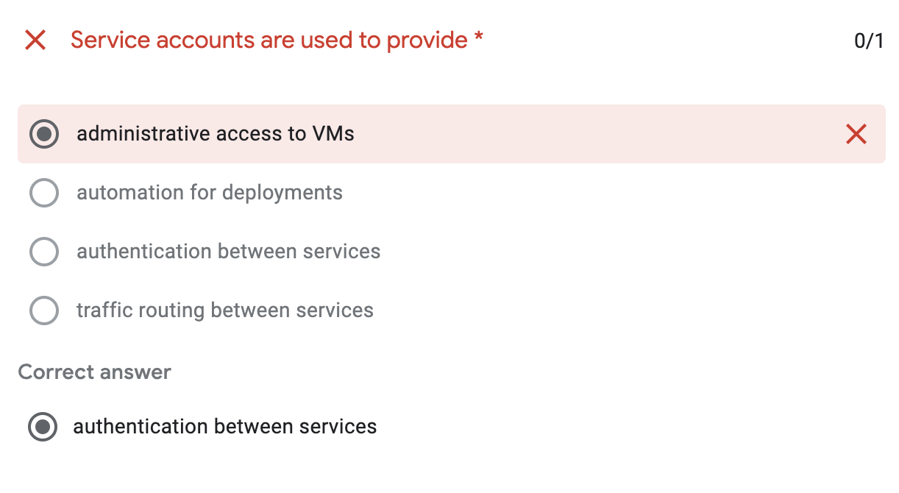
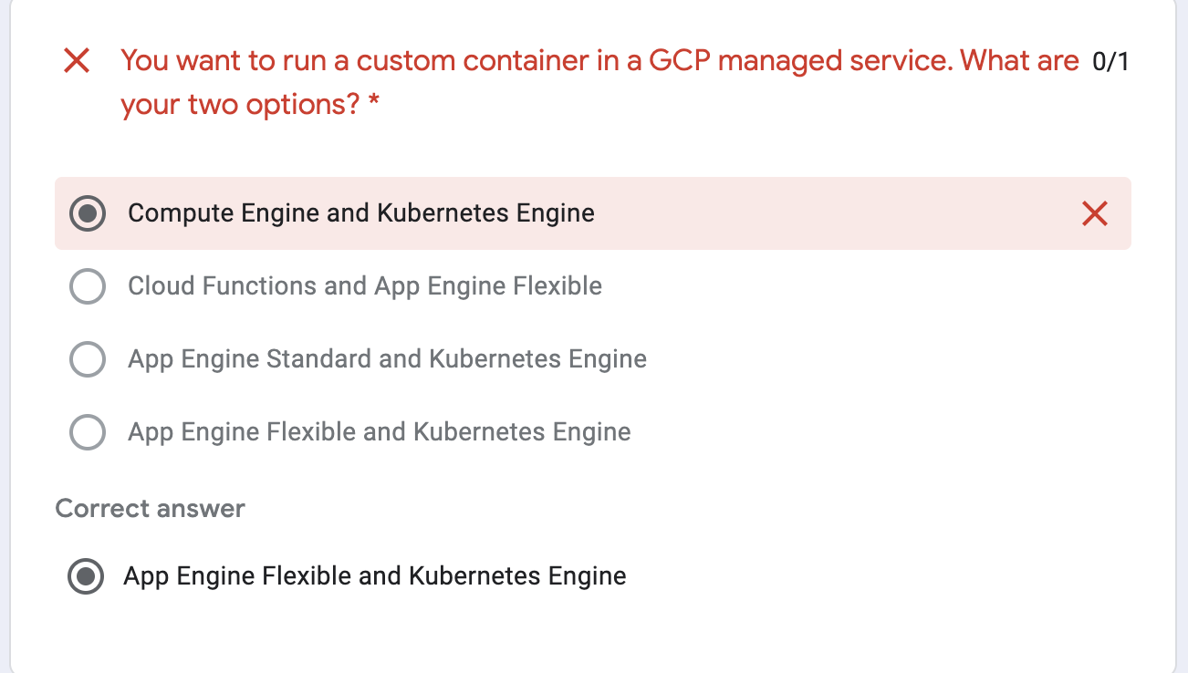
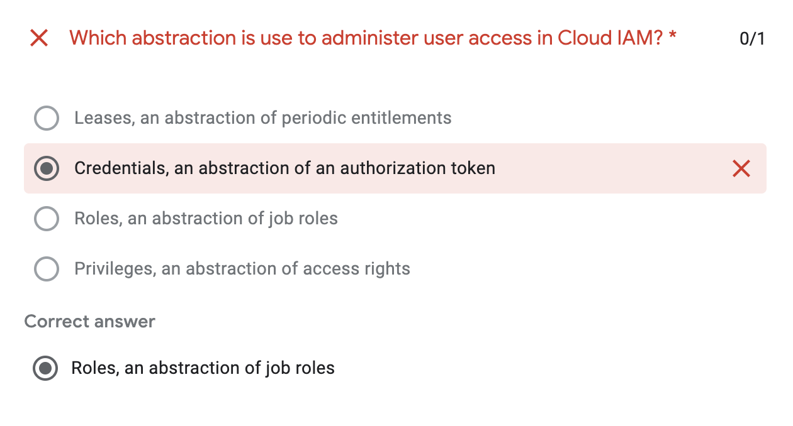
Week 2 quiz
https://docs.google.com/forms/d/e/1FAIpQLSdZwJTphDHlq_rl-ITDEUyJvbgm5q12HJYTwr09VfLCC9oLIA/viewform

Slide 26
Test 1 Whizlab. --→ https://www.whizlabs.com/learn/course/google-cloud-certified-professional-cloud-architect/239/quiz/14776/report/6216091

Slide 27
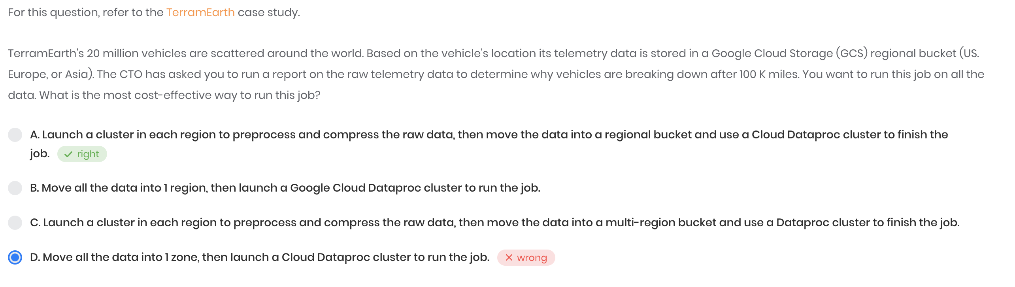
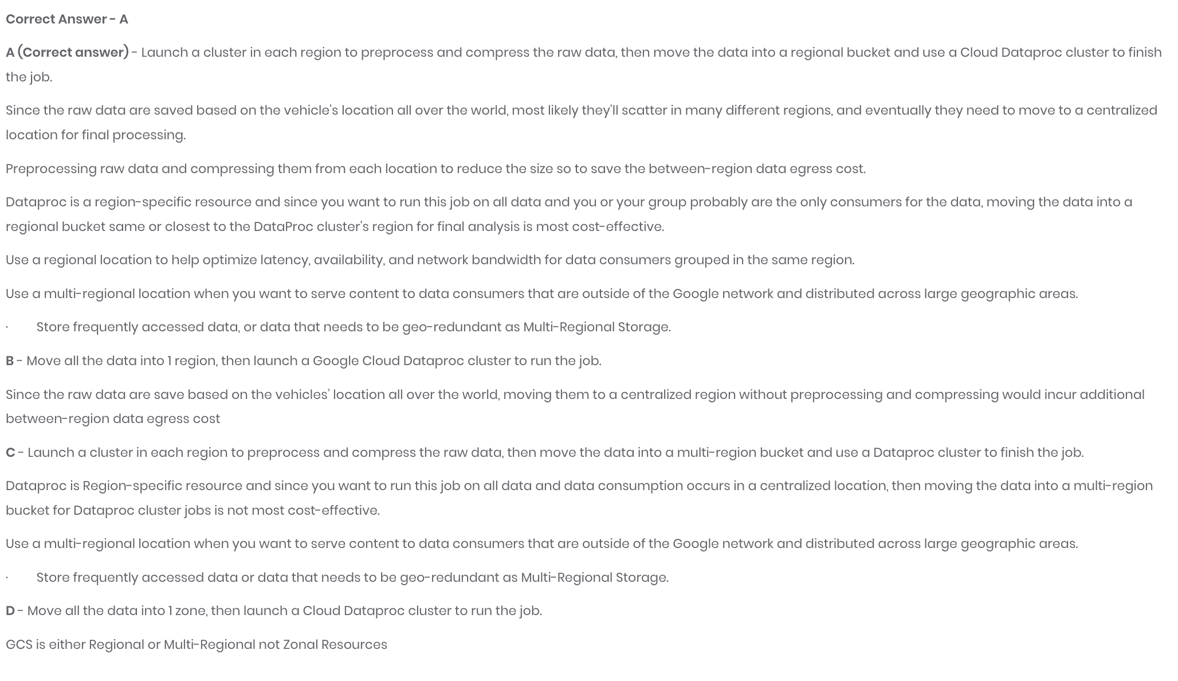

Slide 28
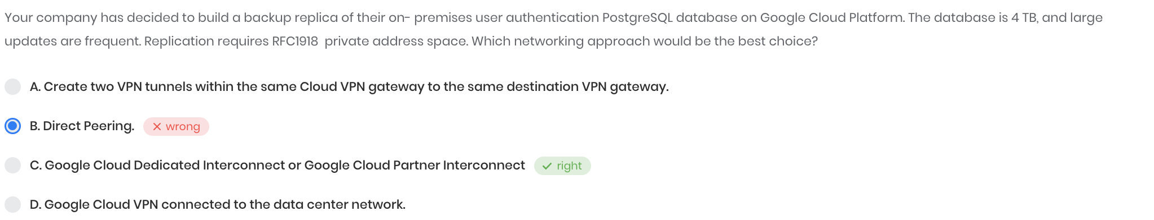
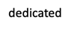
RFC 1918
VPC network peering support internal address (which can be RFC1918 (private access )) - but direct peering does not support RFC 1918
https://cloud.google.com/vpc/docs/vpc-peering Shared VPC support internal IP communication - https://cloud.google.com/vpc/docs/shared-vpc cloud interconnect ( and partner ) support – RFC 1918 - https://cloud.google.com/network-connectivity/docs/interconnect/concepts/overview
Your VPC network's internal IP addresses are directly accessible from your on-premises network. You don't need to use a NAT device or VPN tunnel to reach internal IP addresses.
Difference between different connectivity options (VPN / Interconnect / peering )

Slide 29
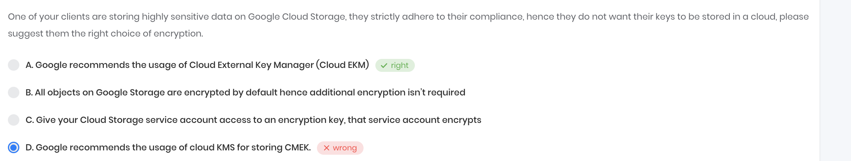
EKM vs KMS
EKM – external key manager - https://cloud.google.com/kms/docs/ekm
CMEK / CSEK / DMK / KMS -- understanding

Slide 30
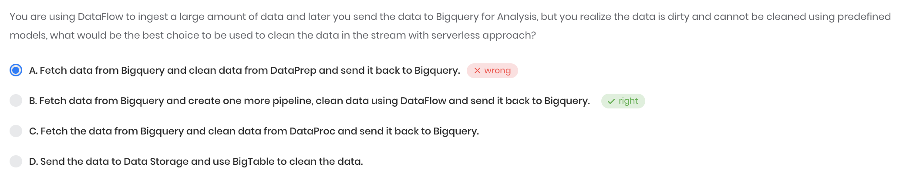
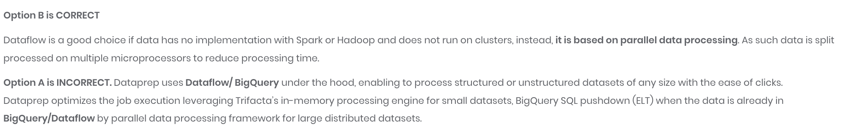
Why again data flow and not DataPrep → because iits mentioned that data can not be cleaned using predefined models , means needed more flexibility which can be provided by data flow
1] Dataprep uses Dataflow or BigQuery under the hood, enabling you to process structured or unstructured datasets of any size with the ease of clicks, not code. 2] Dataprep optimizes the job execution leveraging Trifacta’s in-memory processing engine for small data sets, BigQuery SQL pushdown (ELT) when the data is already in BigQuery, or Dataflow parallel data processing framework for large distributed datasets.
https://cloud.google.com/dataprep
https://www.trifacta.com/blog/why-upgrade-cloud-dataprep-professional/

Slide 31
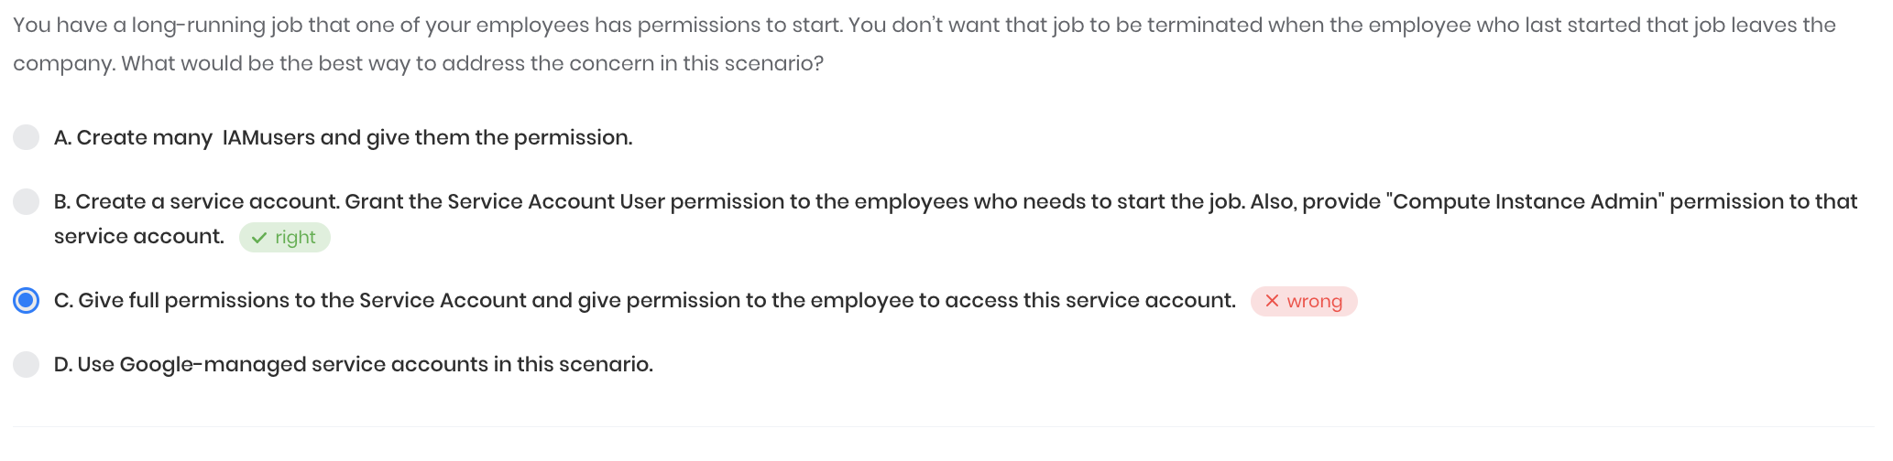
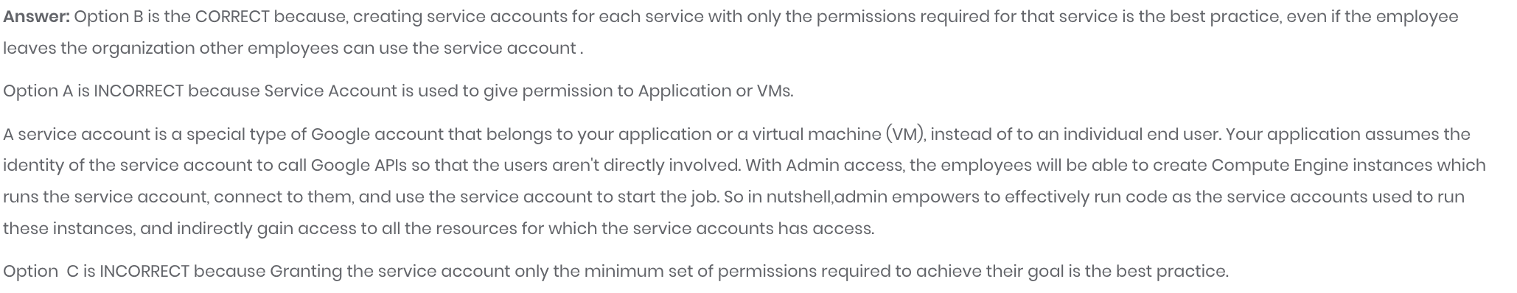
https://cloud.google.com/iam/docs/understanding-service-accounts

Slide 32
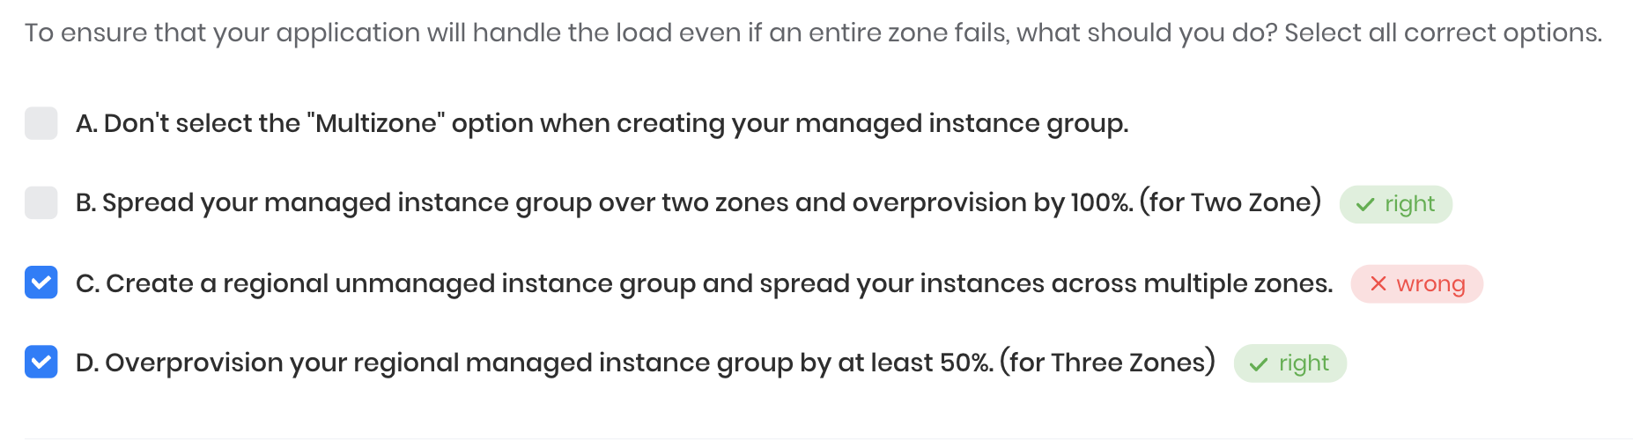
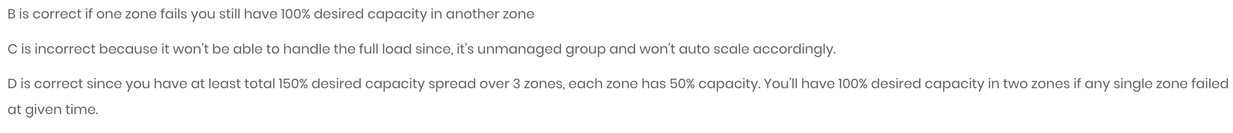
Zone failure – How to handle

Slide 33
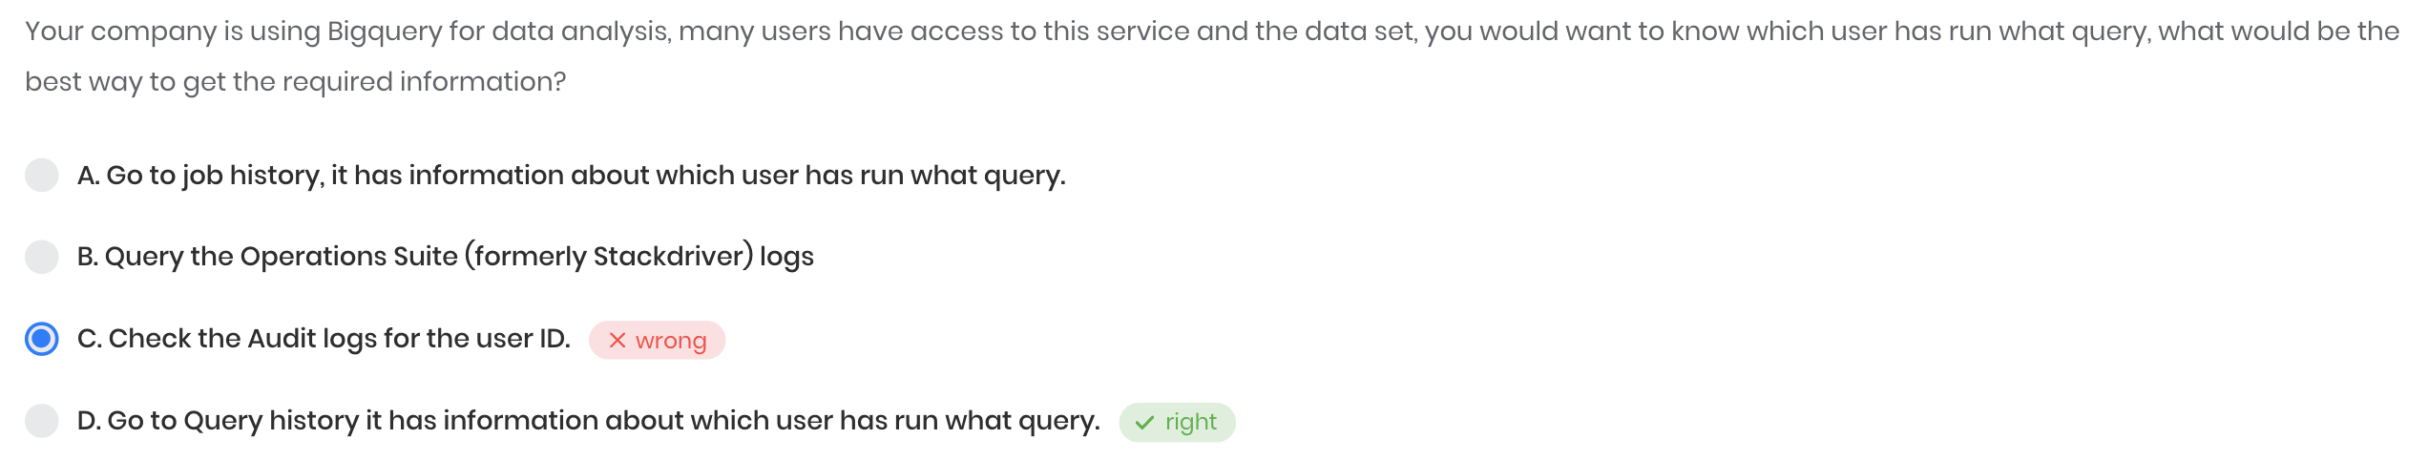
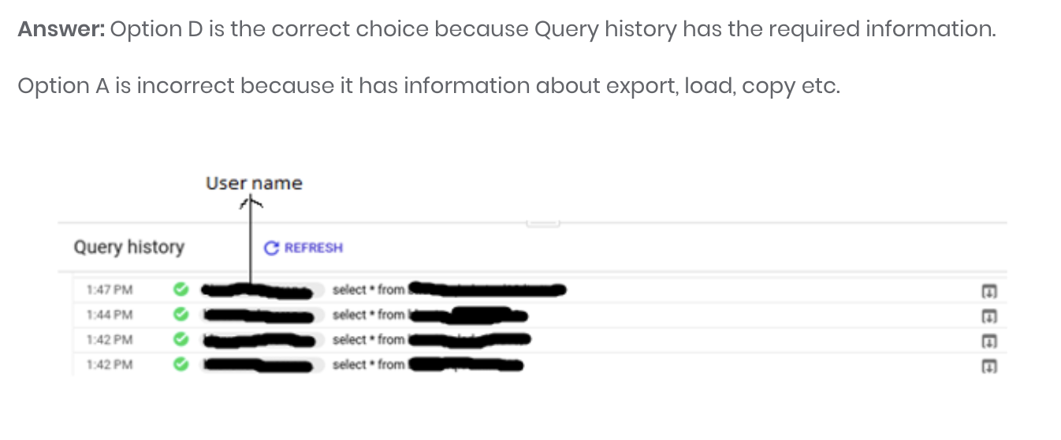
Big Query
Why not Audit log :: Cloud audit logs helps us to answer the questions of "who did what, where, and when?" within your Google Cloud resources.
Since we want to know even the query, we would go with "Query History" option. Audit logs will not have the detailed query a user ran, but just the user and timestamp details.
Why not Job History :: Look, if we are talking about UI - yes. But if we are talking about other options, then this information can be obtained exactly from the job history. INFORMATION.SCHEMA.JOBS_BY_USER is exactly about this. Also you can use REST or bq to get jobs and then describe job.
Why not Stackdriver ::stackdriver will have logs, but it will not show the exact query run by a user.

Slide 34
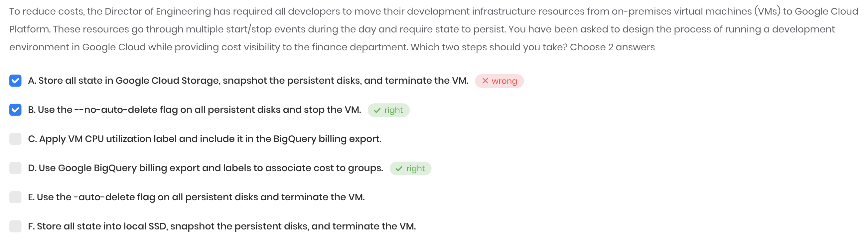
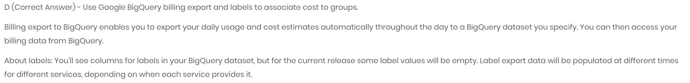
Big Query …

Slide 35
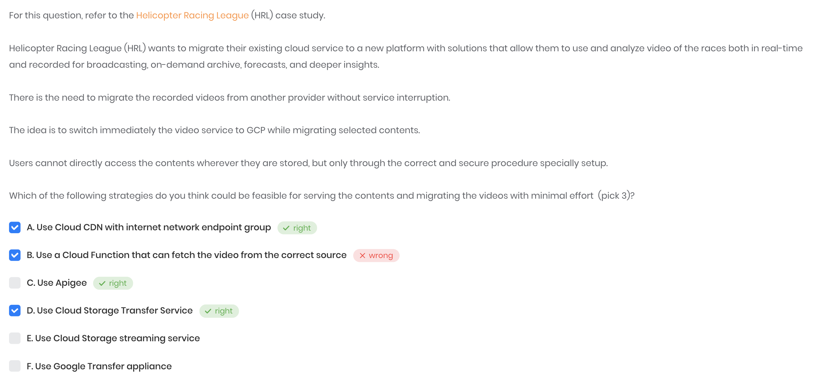

Slide 36
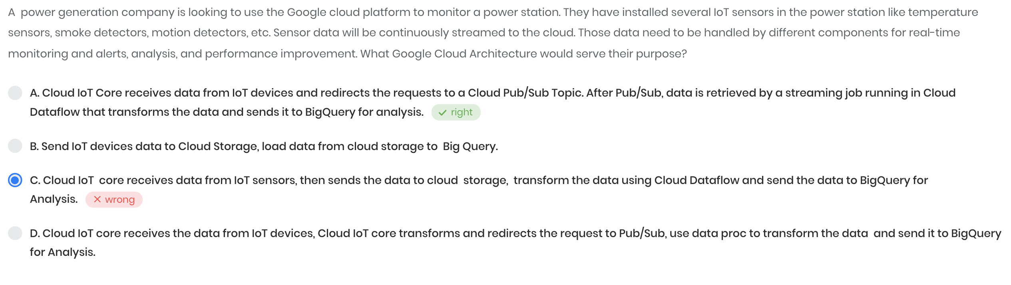
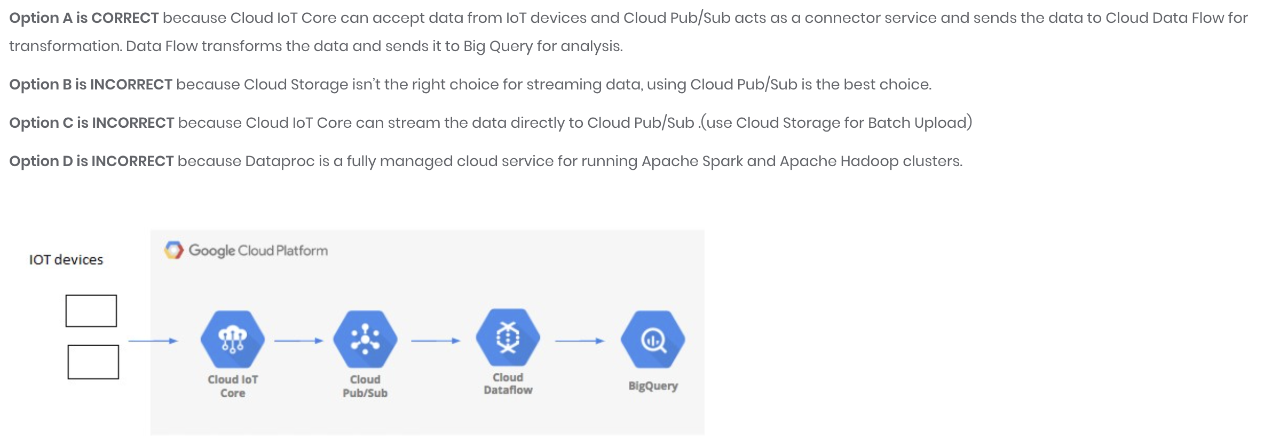
IOT

Slide 37
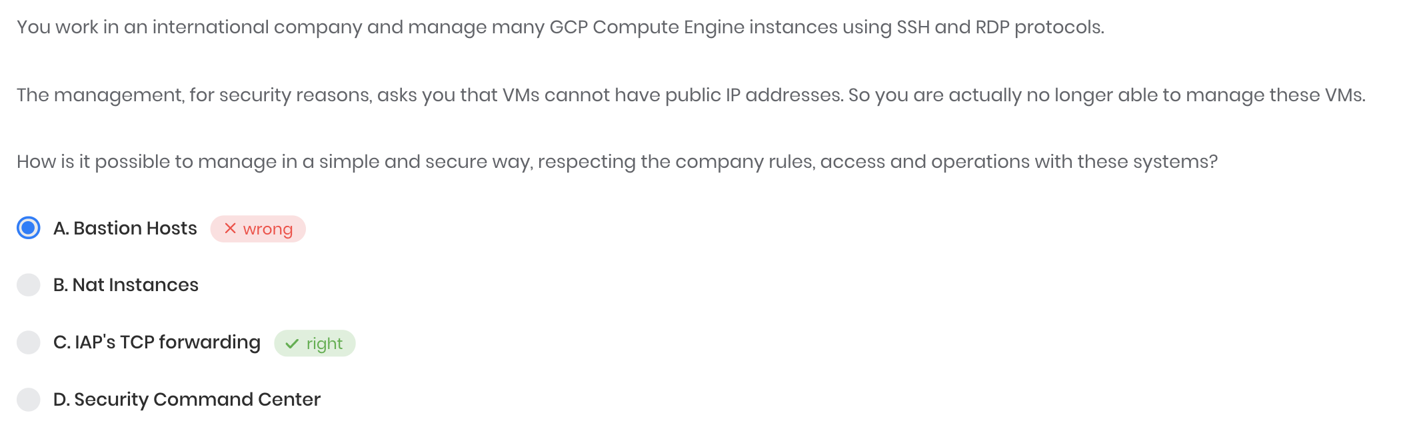
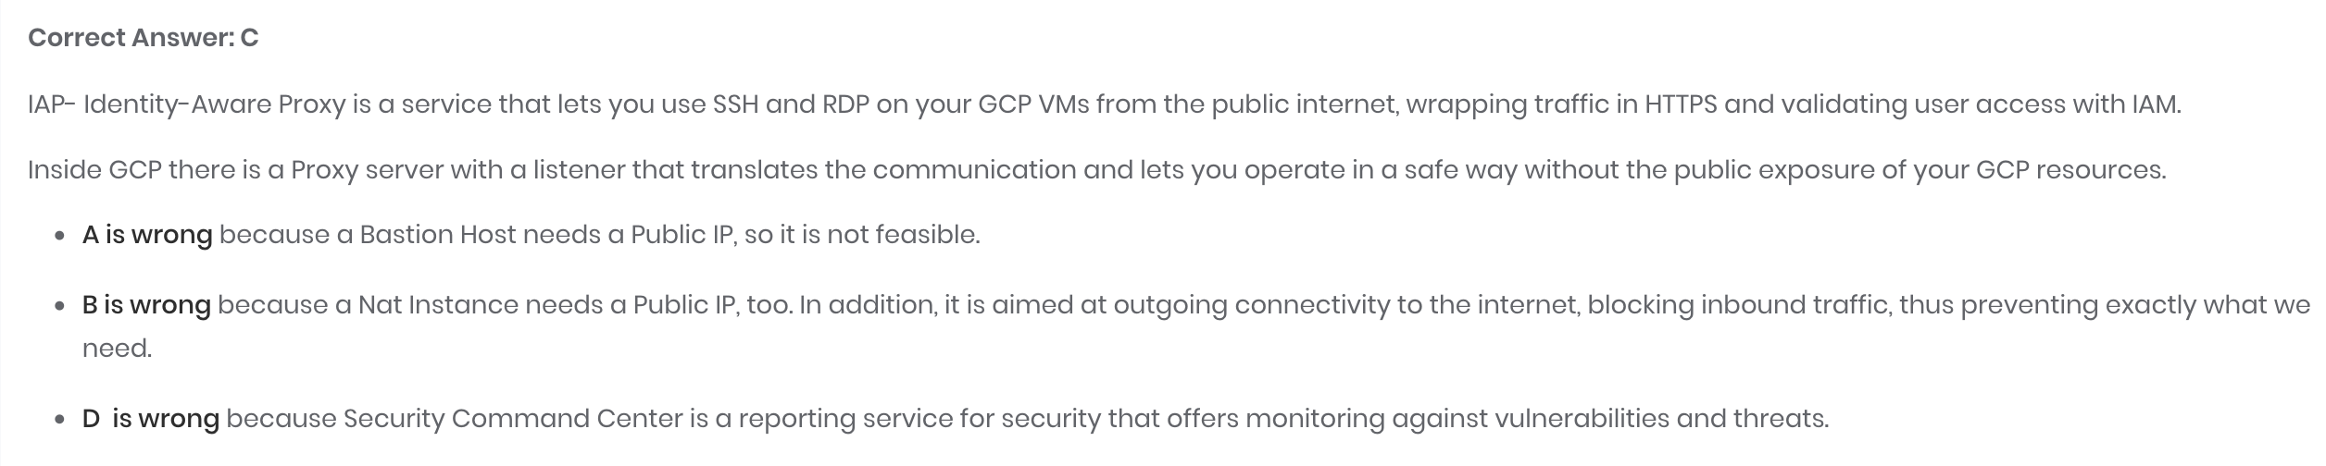
IAP vs Bastion host vs NAT
IAP's TCP forwarding feature lets you control who can access administrative services like SSH and RDP on your backends from the public internet. The TCP forwarding feature prevents these services from being openly exposed to the internet. Instead, requests to your services must pass authentication and authorization checks before they get to their target resource.
Exposing administrative services directly to the internet when running workloads in the cloud introduces risk. Forwarding TCP traffic with IAP allows you to reduce that risk, ensuring only authorized users gain access to these sensitive services.
Since this feature is specifically aimed at administrative services, load-balanced targets aren't supported.
Bastion host vs NAT vs load balancer ::
a bastion host allows inbound access to known IP addresses and authenticated users, a NAT instance allows instances within your VPC to go out to the internet.
A NAT instance, however, allows your private instances outgoing connectivity to the Internet, while at the same time blocking inbound traffic from the Internet.
IAP – TCP forwarding → https://cloud.google.com/iap/docs/tcp-forwarding-overview Why not other options like bastion host :: https://cloud.google.com/solutions/connecting-securely#protecting_services_on_machines_with_external_ip_addresses

Slide 38
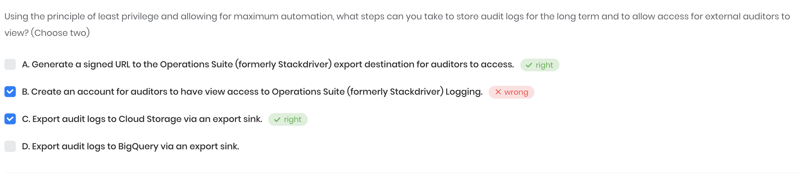
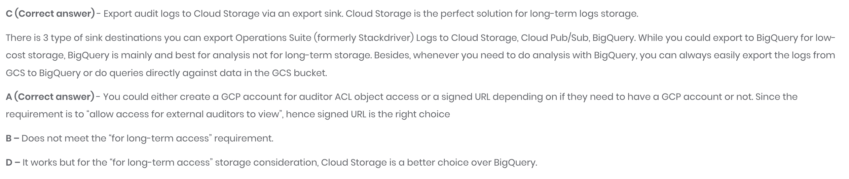
Logging storage problems
Sinks -- https://cloud.google.com/logging/docs/export/configure_export_v2
Logging storage options - https://cloud.google.com/logging/docs/routing/overview

Slide 39
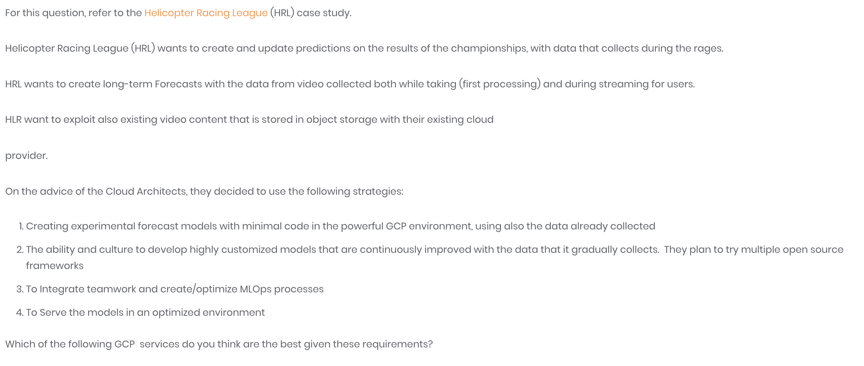
Vertex AI - https://cloud.google.com/vertex-ai
Build, deploy, and scale ML models faster, with pre-trained and custom tooling within a unified artificial intelligence platform.
Build with the groundbreaking ML tools that power Google, developed by Google Research
Deploy more models, faster, with 80% fewer lines code required for custom modelling
Use MLOps tools to easily manage your data and models with confidence and repeat at scale

Slide 40
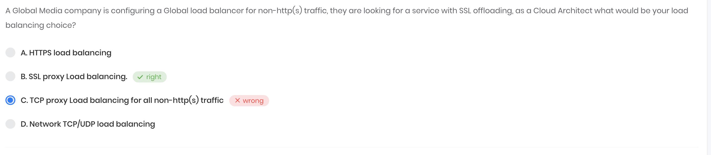
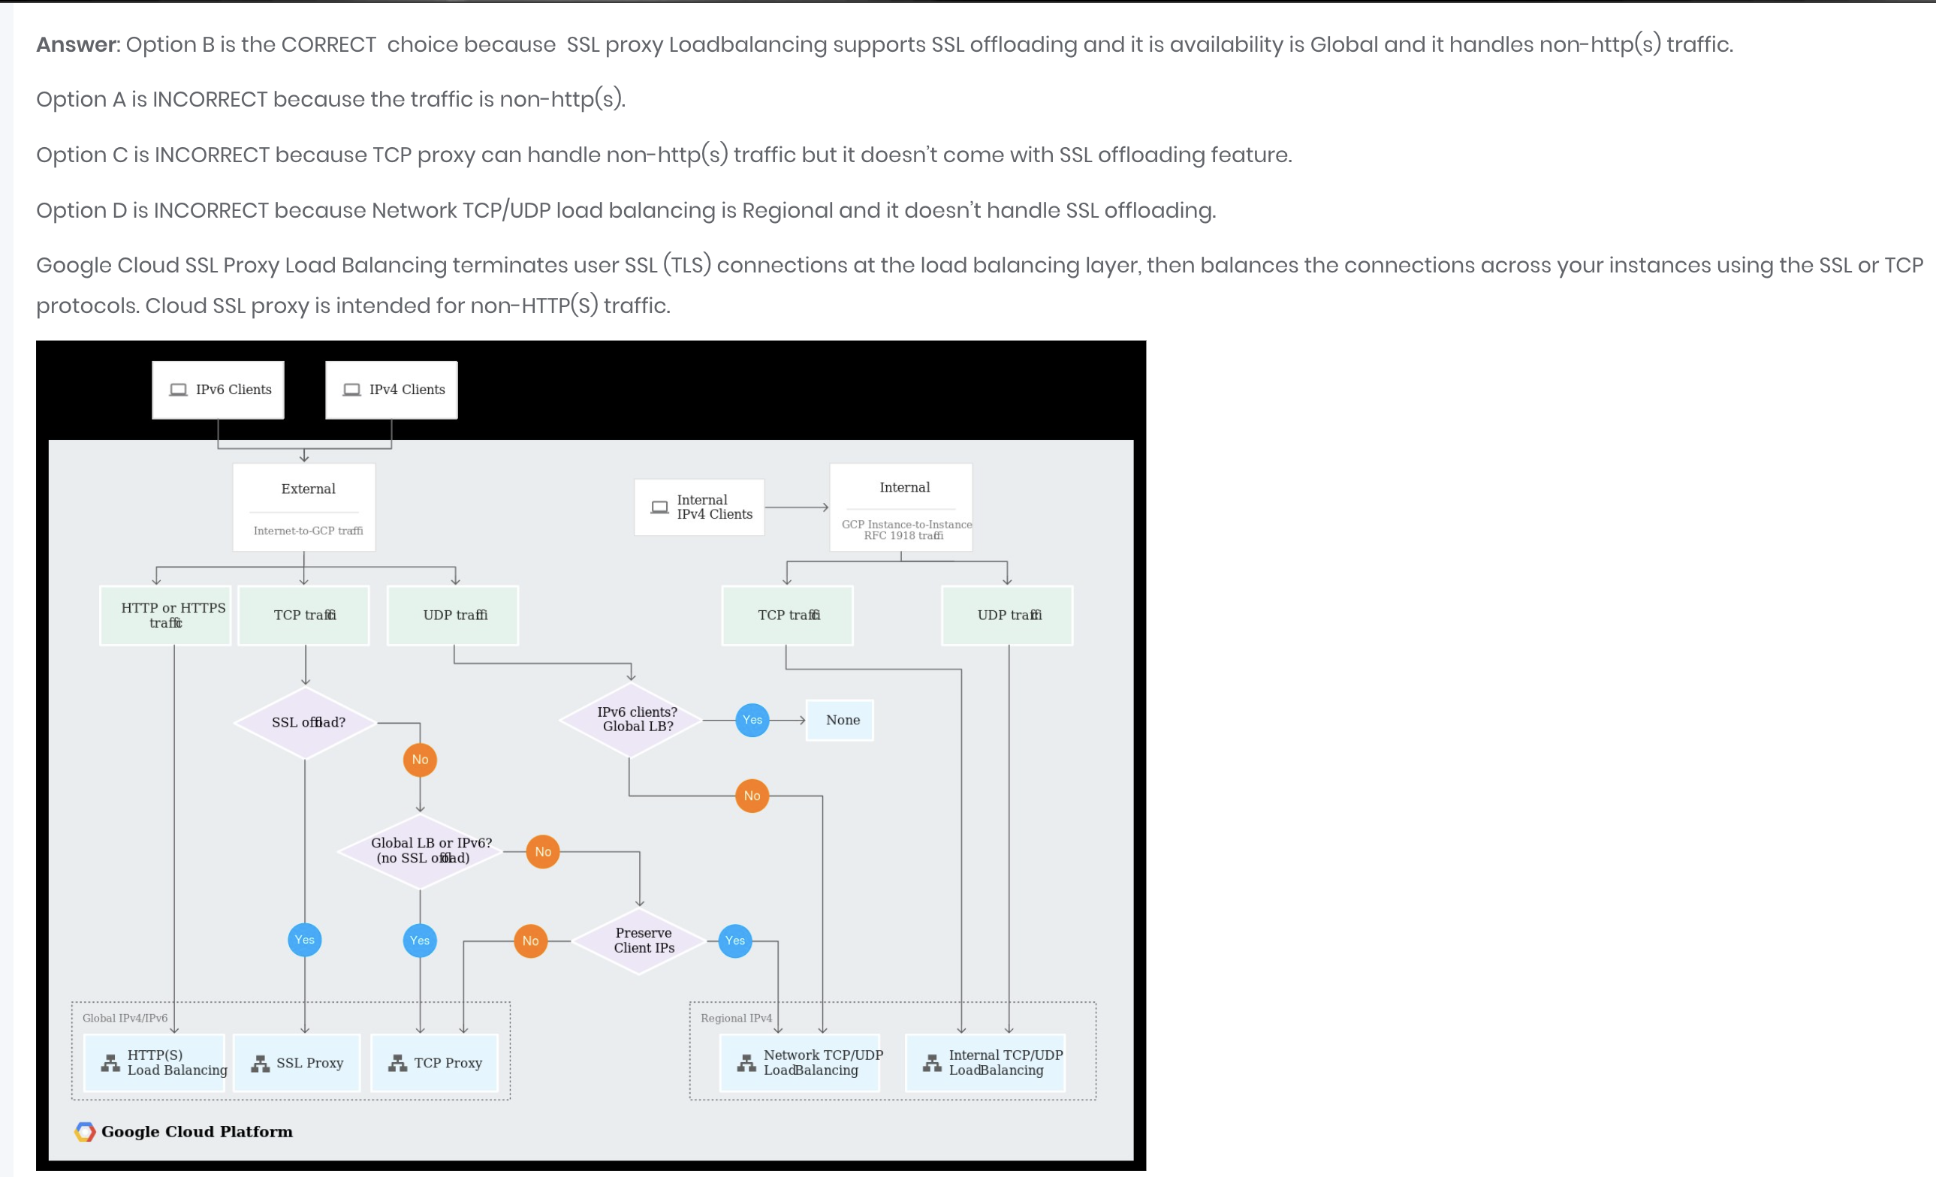
Load balancer – SSl offloading choice -
Load balancer – SSl offloading choice
https://googlecloudarchitect.us/what-exactly-is-ssl-offloading-and-which-gcp-load-balancers-offer-offloading/
https://avinetworks.com/glossary/ssl-offload/

Slide 41
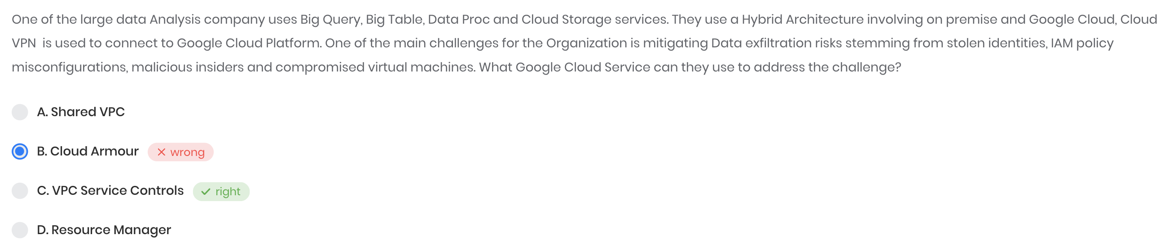
VPC service Control vs Cloud Armor
https://cloud.google.com/vpc-service-controls/docs/overview
VPC Service Controls improves your ability to mitigate the risk of data exfiltration from Google Cloud services such as Cloud Storage and BigQuery. You can use VPC Service Controls to create perimeters that protect the resources and data of services that you explicitly specify.
https://cloud.google.com/armor

Slide 42
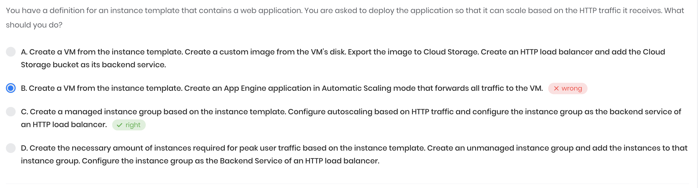
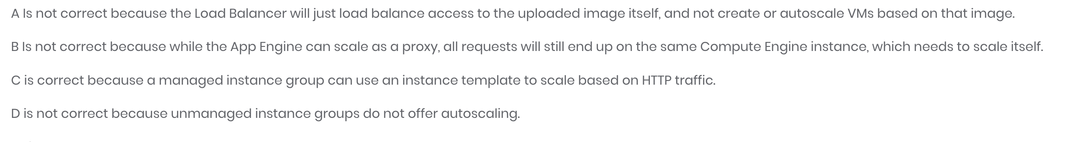

Slide 43
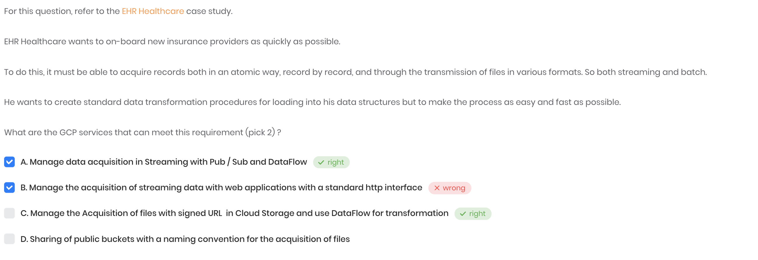
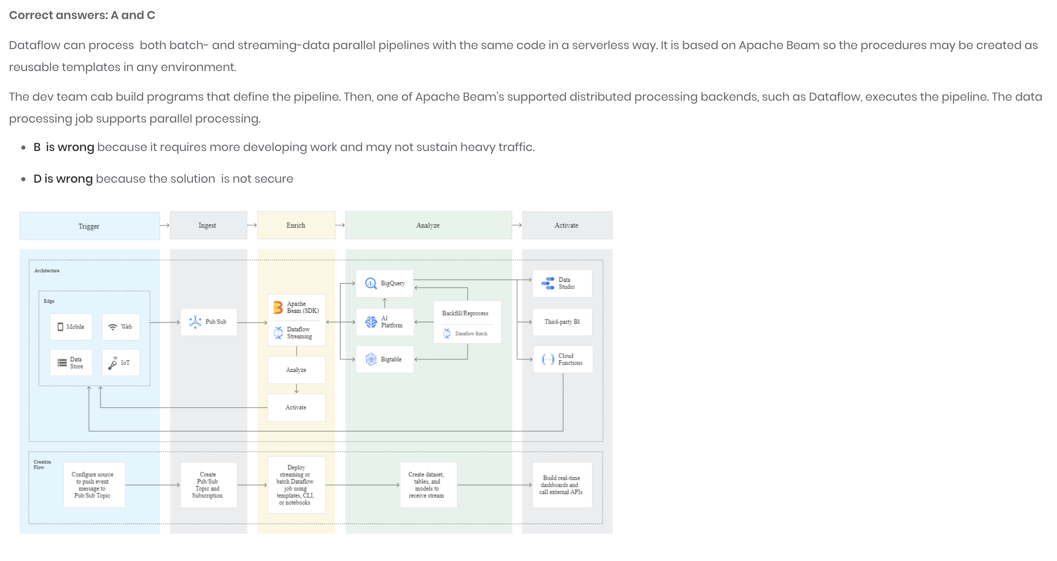

Slide 44
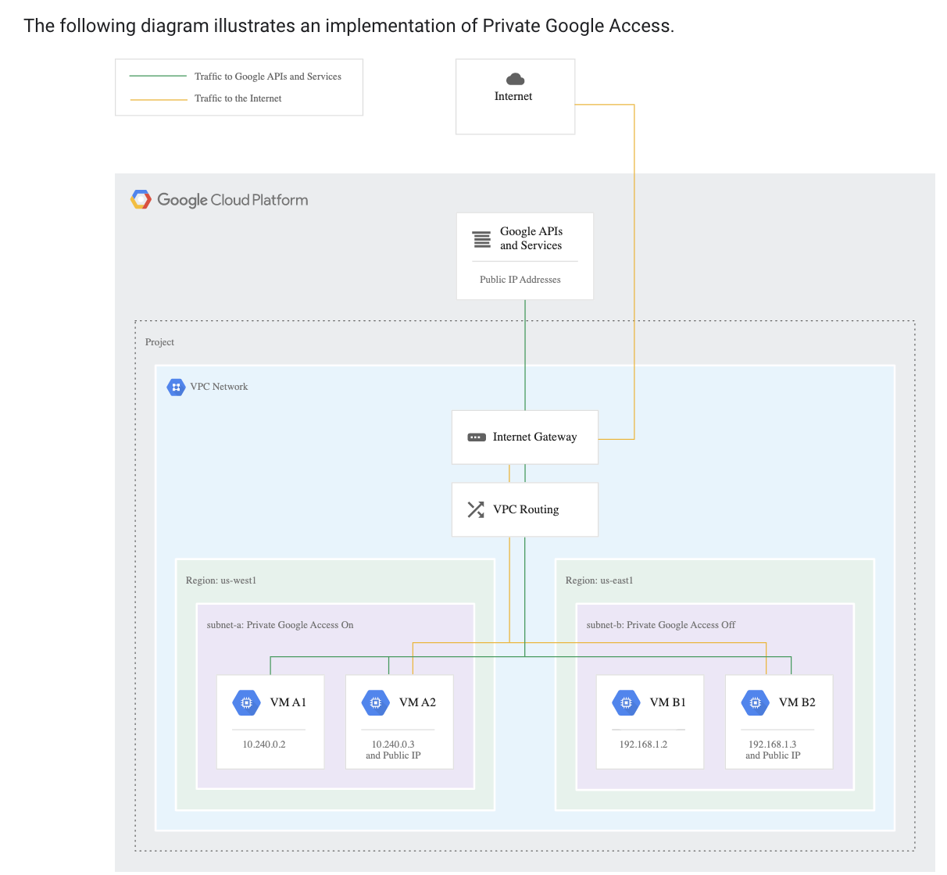
Private google access - https://cloud.google.com/vpc/docs/private-google-access
An IT company has a set of compute engine instances hosted in a VPC. They are not exposed to the internet. These instances now need to install an important security patch. How can the security patch be installed on the instances?
Upload to Cloud Storage and enable VPC peering
Upload to Cloud Storage and whitelist instance IP address
Upload to Cloud Storage and enable Private Google Access
Upload to Cloud Source Repository and enable VPC peering
What this image is saying that VM A2 & B2 are able to connect to both google service and internet as they have public Ip . But VM A1 & B1 are not able to connect to outside network . But if we enable private google access of any of this subnet then private VM can at least be able to connect with Google services / APIs ex – VM A1

Slide 45
VPC flow logs – https://cloud.google.com/vpc/docs/flow-logs https://cloud.google.com/vpc/docs/using-flow-logs
Your security team wants to be able to audit network traffic inside of your network. What’s the best way to ensure they have access to the data they need?
Disable flow logs.
Enable flow logs.
Enable VPC Network logs
Add a firewall capture filter.

Slide 46
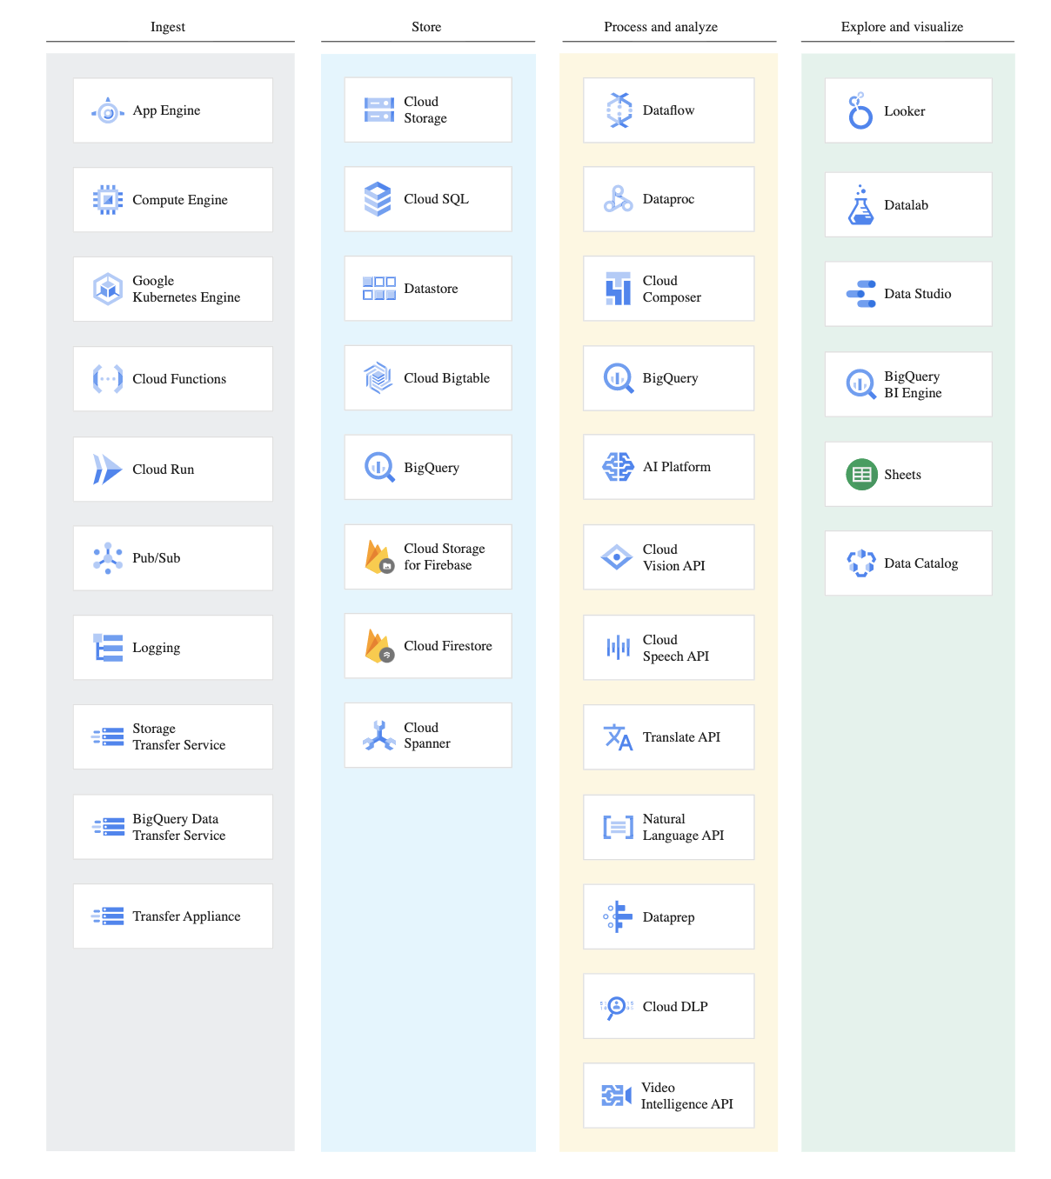
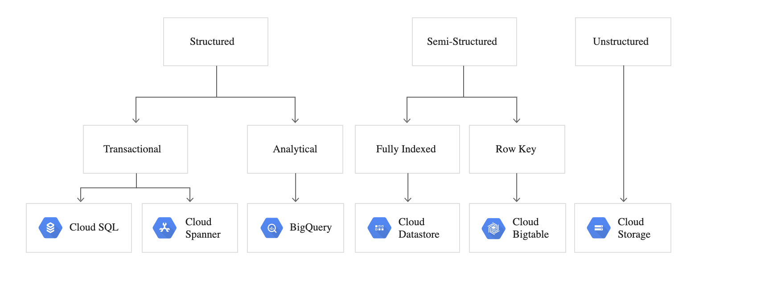
Paper 2 – Wizlab - https://www.whizlabs.com/learn/course/google-cloud-certified-professional-cloud-architect/239/quiz/14800/practice/start
Pub/Sub doesn't provide guarantees about the order of message delivery. Strict message ordering can be achieved with buffering, often using Dataflow.
A common use of Pub/Sub is to move streaming data into Dataflow for real-time processing, per actual event time. When processed, you can move the data into a persistent storage service, such as Datastore and BigQuery, which support queries ordered by app timestamps.
Data lifecycle - https://cloud.google.com/architecture/data-lifecycle-cloud-platform
Cloud SQL is not an appropriate storage system for online analytical processing (OLAP) workloads or data that requires dynamic schemas on a per-object basis. If your workload requires dynamic schemas, consider Datastore. For OLAP workloads, consider BigQuery. If your workload requires wide-column schemas, consider Bigtable.

Slide 47
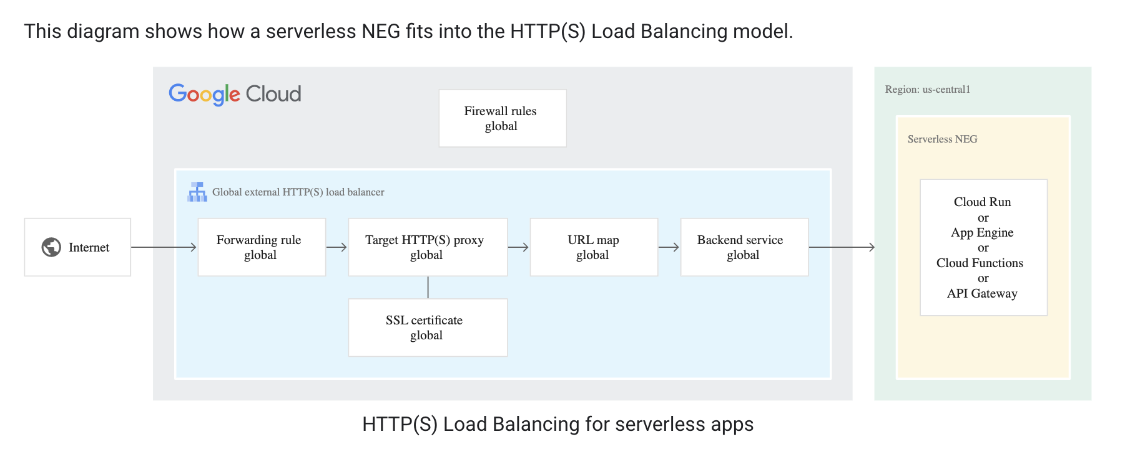
Serverless NEG - Serverless network Endpoint group.
- NEG) specifies a group of backend endpoints for a load balancer - A serverless NEG is a backend that points to a Cloud Run, App Engine, Cloud Functions, or API Gateway service.
For a group of services to be in the same serverless NEG, they must have a common URL pattern.
https://cloud.google.com/load-balancing/docs/negs/serverless-neg-concepts
Mapping a single URL to multiple functionally identical serverless applications is supported only for Cloud Run and Cloud Functions.

Slide 48
Workload identity federation vs Workload identity
Using identity federation, you can grant on-premises or multi-cloud workloads access to Google Cloud resources, without using a service account key.
https://cloud.google.com/iam/docs/workload-identity-federation
With identity federation, you can use Identity and Access Management (IAM) to grant external identities IAM roles, including the ability to impersonate service accounts.
Workload Identity is enabled by default on Autopilot clusters in GKE .
Best practices for Cloud Storage - Avoiding use of sensitive information as part of bucket or object names. For example, instead of naming your bucket mysecretproject-prodbucket, name it somemeaninglesscodename-prod. In some applications, you may want to keep sensitive metadata in custom Cloud Storage headers such as x-goog-meta, rather than encoding the metadata in object names.
Avoid breaking a transfer into smaller chunks if possible and instead upload the entire content in a single chunk but
If you want to bulk delete a hundred thousand or more objects, avoid using gsutil,

Slide 49
Container commands - https://cloud.google.com/kubernetes-engine/docs/how-to/cluster-autoscaler
To create a cluster with autoscaling enabled, use the --enable-autoscaling flag and specify --min-nodes and --max-nodes:
gcloud container clusters create CLUSTER_NAME \ --enable-autoscaling \ --num-nodes NUM_NODES \ --min-nodes MIN_NODES \ --max-nodes MAX_NODES \ --region=COMPUTE_REGION To add a node pool with autoscaling to an existing cluster, use the following command:
gcloud container node-pools create POOL_NAME \ --cluster=CLUSTER_NAME \ --enable-autoscaling \ --min-nodes=MIN_NODES \ --max-nodes=MAX_NODES \ --region=COMPUTE_REGION
To enable autoscaling for an existing node pool use the --enable-autoscaling flag:
gcloud container clusters update CLUSTER_NAME \ --enable-autoscaling \ --node-pool=POOL_NAME \ --min-nodes=MIN_NODES \ --max-nodes=MAX_NODES \ --region=COMPUTE_REGION
To disable autoscaling for a specific node pool, use the --no-enable-autoscaling flag:
gcloud container clusters update CLUSTER_NAME \ --no-enable-autoscaling \ --node-pool=POOL_NAME \ --region=COMPUTE_REGION
Imp Question : If you want to manually resize a node pool in your cluster that has autoscaling enabled, perform the following:
1.Disable autoscaling (command given above )
2. Manual resize - gcloud container clusters resize CLUSTER_NAME --node-pool POOL_NAME --num-nodes NUM_NODES
3. Reenable autoscaling with update command specifying the min-node and max-node parameter.
Note** min-node / max-node used with create and update command with resize we use num-nodes

Slide 50
Subnet

Slide 52






https://partner.cloudskillsboost.google/course_sessions/905356/quizzes/104994

Slide 53


As a reminder, Cloud NAT logs are generated for the following sequences:
When a network connection using NAT is created.
When a packet is dropped because no port was available for NAT.
Normally the boot disk defaults to being deleted automatically when the instance is deleted. But sometimes you will want to override this behavior. This feature is very important because you cannot create an image from a boot disk when it is attached to a running instance. So you would need to disable Delete boot disk when instance is deleted to enable creating a system image from the boot disk.
Google Cloud Virtual Private Cloud (VPC) provides networking functionality to Compute Engine virtual machine (VM) instances, Kubernetes Engine containers, and the App Engine flexible environment. ** no role of VPC in app engine standard
If you start the Minecraft server again now, it is tied to the life of your SSH session: that is, if you close your SSH terminal, the server is also terminated. To avoid this issue, you can use screen, an application that allows you to create a virtual terminal that can be "detached," becoming a background process, or "reattached," becoming a foreground process. When a virtual terminal is detached to the background, it will run whether you are logged in or not.
VM instances without external IP addresses are isolated from external networks. Using Cloud NAT, these instances can access the internet for updates and patches, and in some cases, for bootstrapping. As a managed service, Cloud NAT provides high availability without user management and intervention.

Slide 54





The service account also has the Project Editor role permissions, which are very broad and do not follow the principle of least privilege.

Slide 55











https://dzone.com/articles/understanding-retry-pattern-with-exponential-back

Slide 56

Google Sample exam improvement report https://cloud.google.com/certification/sample-questions/cloud-architect
Attempt 1 – 10 / 17 Attempt 2 – 12 / 17 = 4 new correct – but 2 previous wrong

Slide 57
Today, TerramEarth maintenance workers receive interactive performance graphs for the last 24 hours (86,400 events) by plugging their maintenance tablets into the vehicle. The support group wants support technicians to view this data remotely to help troubleshoot problems. You want to minimize the latency of graph loads. How should you provide this functionality?
A. Execute queries against data stored in a Cloud SQL.
B. Execute queries against data indexed by vehicle_id.timestamp in Cloud Bigtable.
C. Execute queries against data stored on daily partitioned BigQuery tables.
D. Execute queries against BigQuery with data stored in Cloud Storage via BigQuery federation.
Correct answer
B. Execute queries against data indexed by vehicle_id.timestamp in Cloud Bigtable.
Feedback
A is not correct because Cloud SQL provides relational database services that are well suited to OLTP workloads, but not storage and low-latency retrieval of time-series data. B is correct because Cloud Bigtable is optimized for time-series data. It is cost-efficient, highly available, and low-latency. It scales well. Best of all, it is a managed service that does not require significant operations work to keep running. C is not correct because BigQuery is fast for wide-range queries, but it is not as well optimized for narrow-range queries as Cloud Bigtable is. Latency will be an order of magnitude shorter with Cloud Bigtable for this use. D is not correct because the objective is to minimize latency, and although BigQuery federation offers tremendous flexibility, it doesn't perform as well as native BigQuery storage, and will have longer latency than Cloud Bigtable for narrow-range queries.
https://cloud.google.com/bigquery/external-data-sources
https://cloud.google.com/bigtable/docs/schema-design-time-series#time-series-cloud-bigtable

Slide 58
Your company wants to deploy several microservices to help their system handle elastic loads. Each microservice uses a different version of software libraries. You want to enable their developers to keep their development environment in sync with the various production services. Which technology should you choose?
A. RPM/DEB
B. Containers
C. Chef/Puppet
D. Virtual machines
Correct answer
B. Containers
Feedback
A is not correct because although OS packages are a convenient way to distribute and deploy libraries, they don't directly help with synchronizing. Even with a common repository, the development environments will probably deviate from production. B is correct because using containers for development, test, and production deployments abstracts away system OS environments, so that a single host OS image can be used for all environments. Changes that are made during development are captured using a copy on-write filesystem, and teams can easily publish new versions of the microservices in a repository. C is not correct because although infrastructure configuration as code can help unify production and test environments, it is very difficult to make all changes during development this way. D is not correct because virtual machines run their own OS, which will eventually deviate in each environment, just as now.

Slide 59
Your organization has a 3-tier web application deployed in the same Google Cloud Virtual Private Cloud (VPC). Each tier (web, API, and database) scales independently of the others. Network traffic should flow through the web to the API tier, and then on to the database tier. Traffic should not flow between the web and the database tier. How should you configure the network with minimal steps?
A. Add each tier to a different subnetwork.
B. Set up software-based firewalls on individual VMs.
C. Add tags to each tier and set up routes to allow the desired traffic flow.
D. Add tags to each tier and set up firewall rules to allow the desired traffic flow.
**** Should understand first the difference in route and firewall ?????
A is not correct because the subnetwork alone will not allow and restrict traffic as required without firewall rules. B is not correct because this adds complexity to the architecture and the instance configuration. C is not correct because routes still require firewall rules to allow traffic as requests. Additionally, the tags are used for defining the instances the route applies to, and not for identifying the next hop. The next hop is either an IP range or instance name, but in the proposed solution the tiers are only identified by tags. D is correct because as instances scale, they will all have the same tag to identify the tier. These tags can then be leveraged in firewall rules to allow and restrict traffic as required, because tags can be used for both the target and source.
https://cloud.google.com/vpc/docs/using-vpc
https://cloud.google.com/vpc/docs/routes
https://cloud.google.com/vpc/docs/add-remove-network-tags

Slide 60
Mountkirk Games has deployed their new backend on Google Cloud Platform (GCP). You want to create a thorough testing process for new versions of the backend before they are released to the public. You want the testing environment to scale in an economical way. How should you design the process?
A. Create a scalable environment in Google Cloud for simulating production load.
B. Use the existing infrastructure to test the Google Cloud-based backend at scale.
C. Build stress tests into each component of your application and use resources from the already deployed production backend to simulate load.
D. Create a set of static environments in Google Cloud to test different levels of load—for example, high, medium, and low.
Correct answer
A. Create a scalable environment in Google Cloud for simulating production load.
Feedback
A is correct because simulating production load in Google Cloud can scale in an economical way. B is not correct because one of the pain points about the existing infrastructure was precisely that the environment did not scale well. C is not correct because it is a best practice to have a clear separation between test and production environments. Generating test load should not be done from a production environment. D is not correct because Mountkirk Games wants the testing environment to scale as needed. Defining several static environments for specific levels of load goes against this requirement.
https://cloud.google.com/community/tutorials/load-testing-iot-using-gcp-and-locust
https://github.com/GoogleCloudPlatform/distributed-load-testing-using-kubernetes

Slide 61
To reduce costs, the Director of Engineering has required all developers to move their development infrastructure resources from on-premises virtual machines (VMs) to Google Cloud. These resources go through multiple start/stop events during the day and require state to persist. You have been asked to design the process of running a development environment in Google Cloud while providing cost visibility to the finance department. Which two steps should you take? (choose two)
A. Use persistent disks to store the state. Start and stop the VM as needed.
B. Use the --auto-delete flag on all persistent disks before stopping the VM.
C. Apply VM CPU utilization label and include it in the BigQuery billing export.
D. Use BigQuery billing export and labels to relate cost to groups.
E. Store all state in a Local SSD, snapshot the persistent disks, and terminate the VM.
Correct answer
A. Use persistent disks to store the state. Start and stop the VM as needed.
D. Use BigQuery billing export and labels to relate cost to groups.
Feedback
A is correct because persistent disks will not be deleted when an instance is stopped. B is not correct because the --auto-delete flag has no effect unless the instance is deleted. Stopping an instance does not delete the instance or the attached persistent disks. C is not correct because labels are used to organize instances, not to monitor metrics. D is correct because exporting daily usage and cost estimates automatically throughout the day to a BigQuery dataset is a good way of providing visibility to the finance department. Labels can then be used to group the costs based on team or cost center. E is not correct because the state stored in local SSDs will be lost when the instance is stopped.
https://cloud.google.com/compute/docs/instances/instance-life-cycle
https://cloud.google.com/sdk/gcloud/reference/compute/instances/set-disk-auto-delete#--auto-delete
https://cloud.google.com/sdk/gcloud/reference/compute/instances/create#--disk
https://cloud.google.com/compute/docs/disks/local-ssd#data_persistence
https://cloud.google.com/billing/docs/how-to/export-data-bigquery
https://cloud.google.com/resource-manager/docs/creating-managing-labels

Slide 68
Wizlab – paper 2 https://www.whizlabs.com/learn/course/google-cloud-certified-professional-cloud-architect/239/quiz/14800/practice/start

Slide 69
what is federated mode in cluster
Parallel ssh
How to automate deployment in container ?
How to upload big files in google cloud storage ?
-r , -m options in large file transfer command to cloud storage ? - https://cloud.google.com/storage/docs/working-with-big-data
Is compression useful ?

Slide 70
Course --- challenge labs udemy papers – 4 Whizlab paper – 10 SAMPLE PAPER BITCERT paper practice papers --

